Slide 1
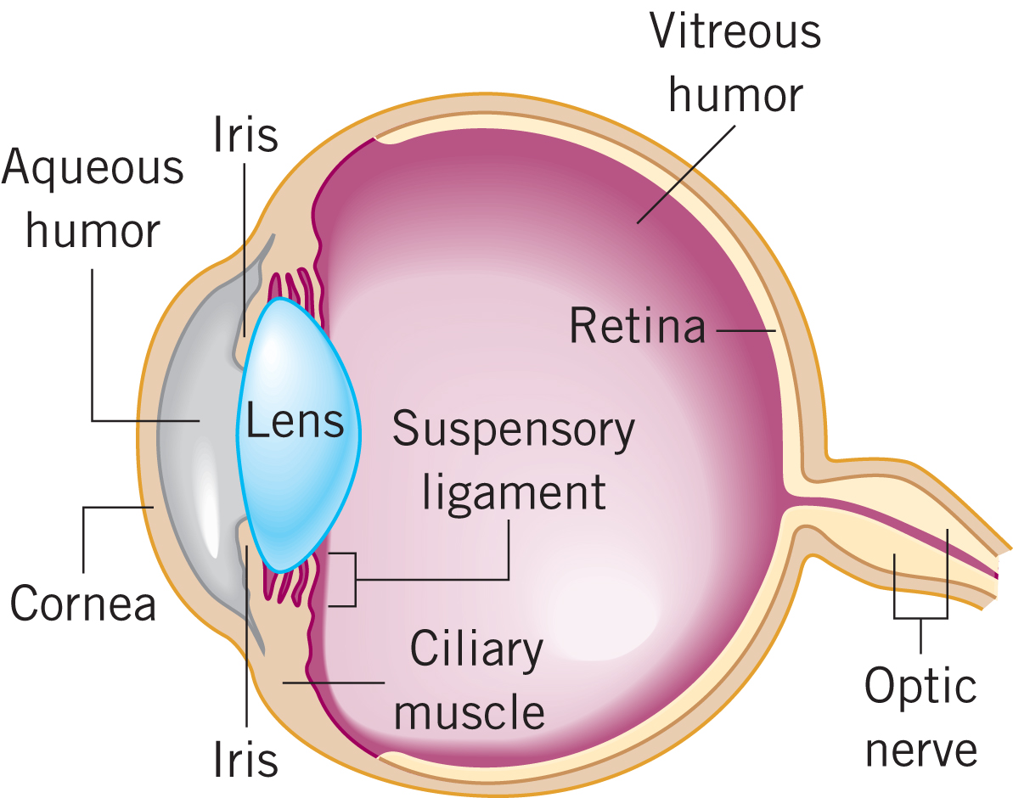
26.10 The Human Eye
ANATOMY

Slide 2
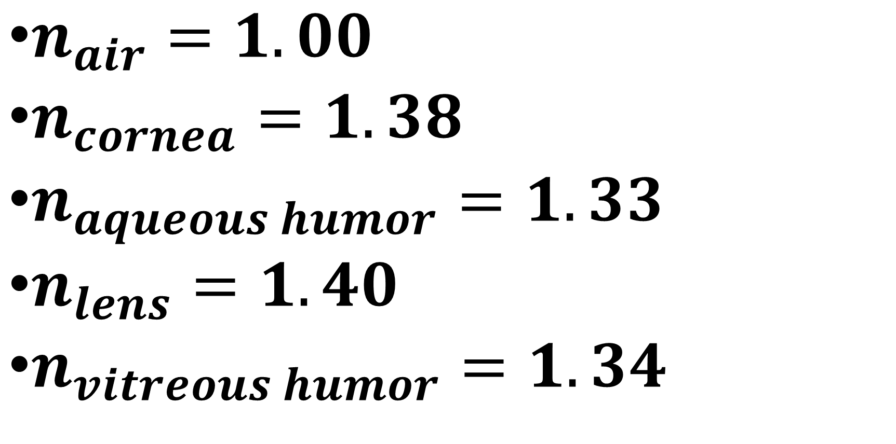
Indices of Refraction for Eye
$n_{air}=1.00$
$n_{cornea}=1.38$
$n_{aqueous humor}=1.33$
$n_{lens}=1.40$
$n_{vitreous humor}=1.34$

Slide 3
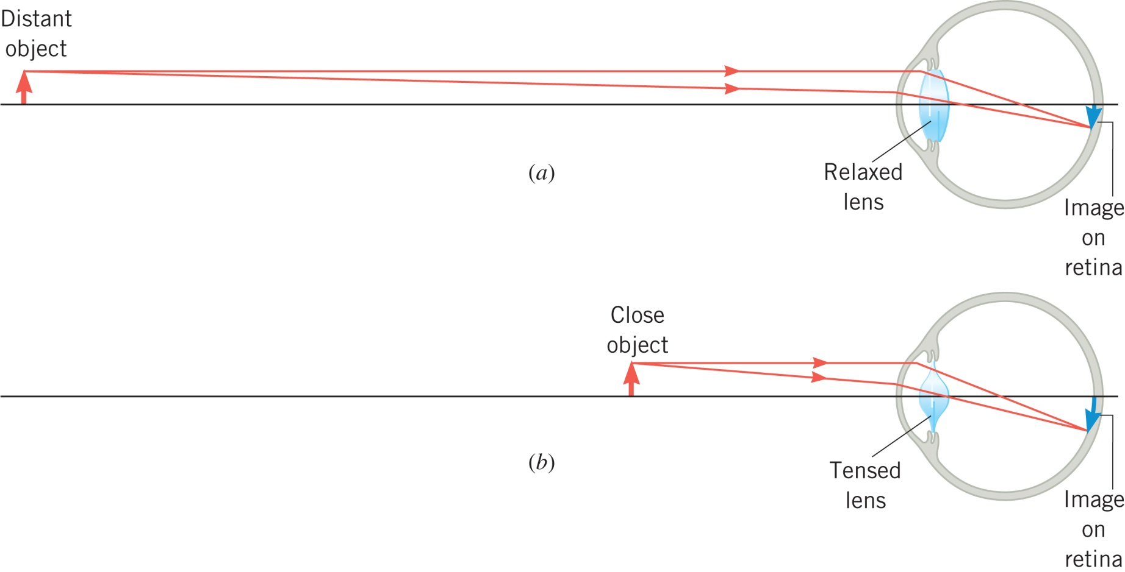
26.10 The Human Eye
OPTICS
The lens only contributes about 20-25% of the refraction, but its function
is important.

Slide 4
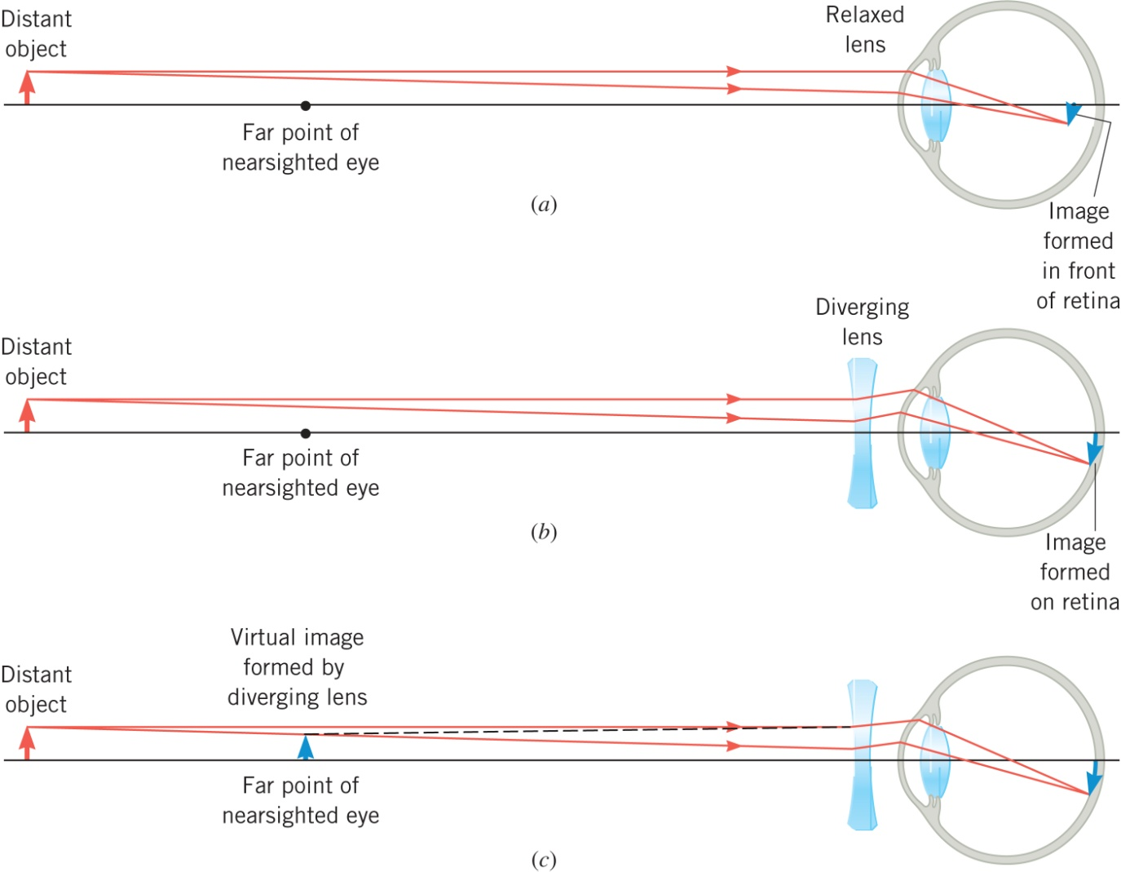
26.10 The Human Eye
NEARSIGNTEDNESS
The lens creates an image of the distance object at the far point
of the nearsighted eye.

Slide 5
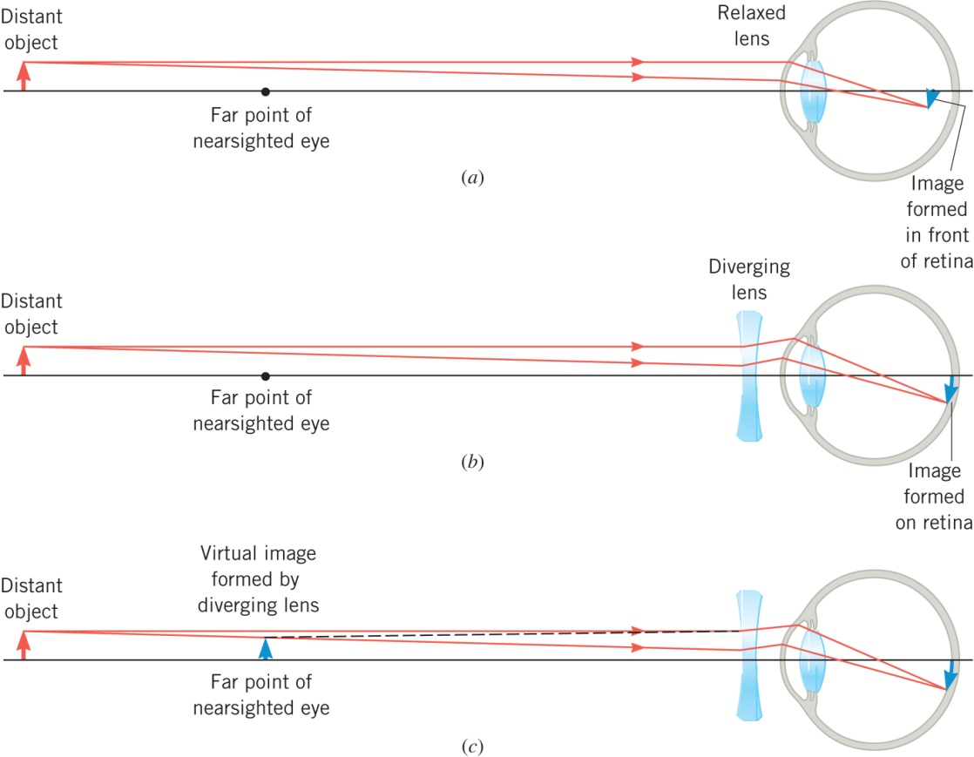
26.10 The Human Eye
Example 12 Eyeglasses for the Nearsighted Person
A nearsighted person has a far point located only 521 cm from the
eye. Assuming that eyeglasses are to be worn 2 cm in front of the
eye, find the focal length needed for the diverging lens of the glasses
so the person can see distant objects.

Slide 6
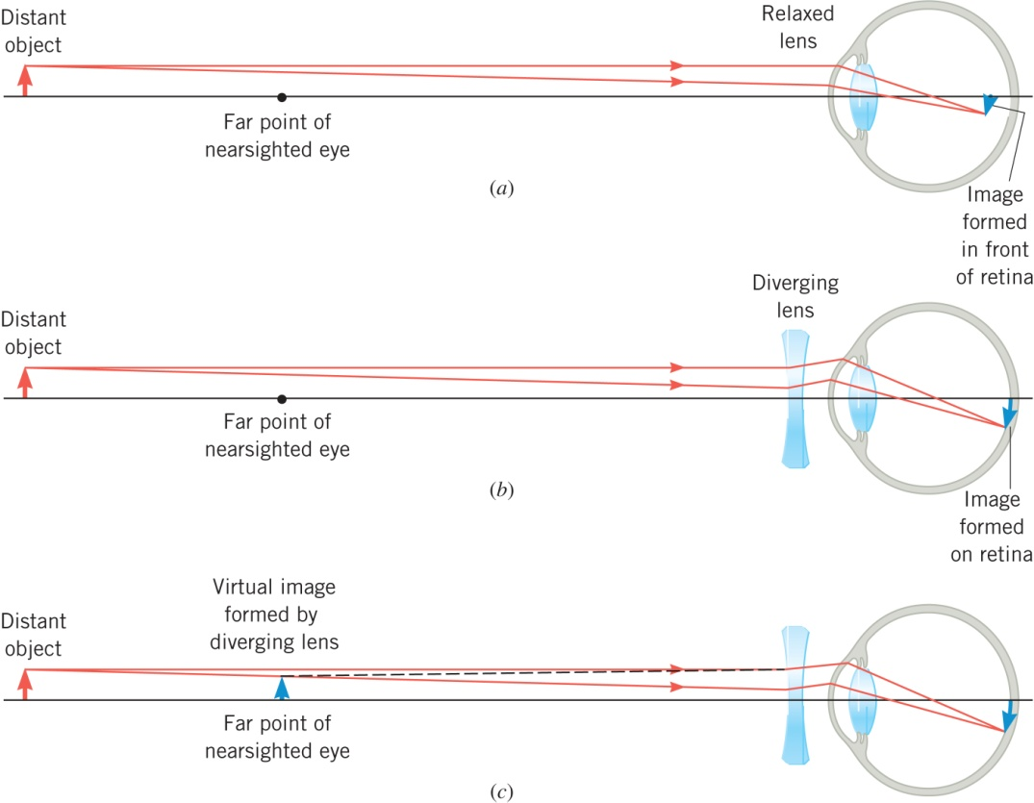
26.10 The Human Eye

Slide 7
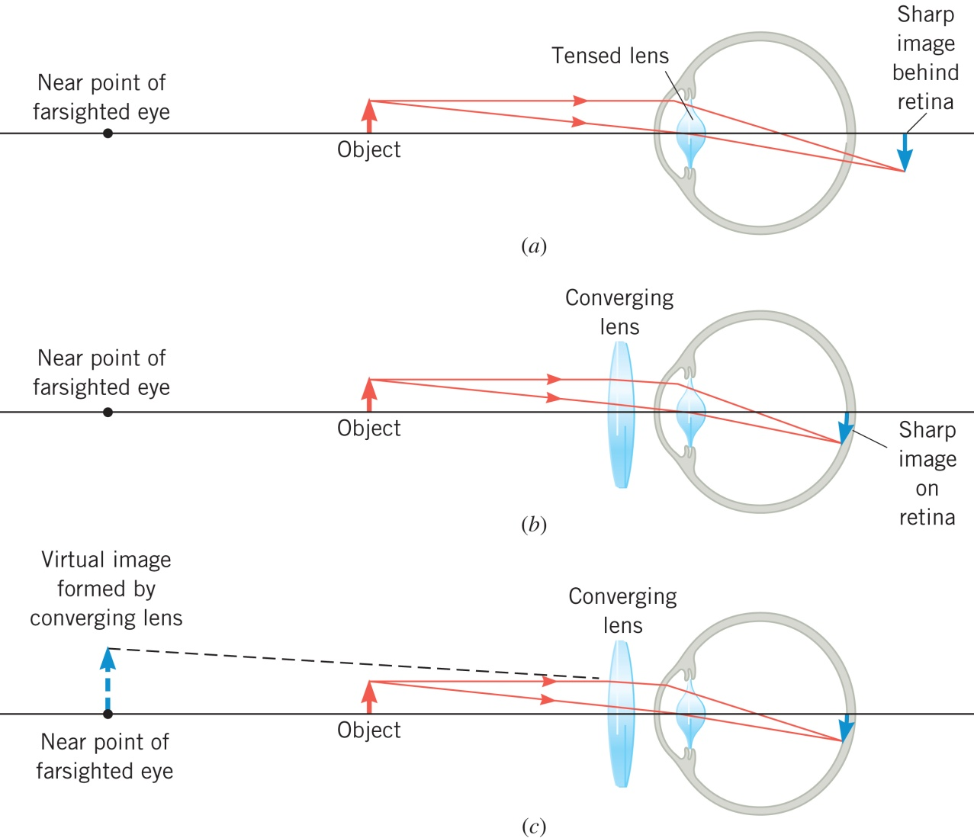
26.10 The Human Eye
FARSIGNTEDNESS
The lens creates an image of the close object at the near point
of the farsighted eye.

Slide 8
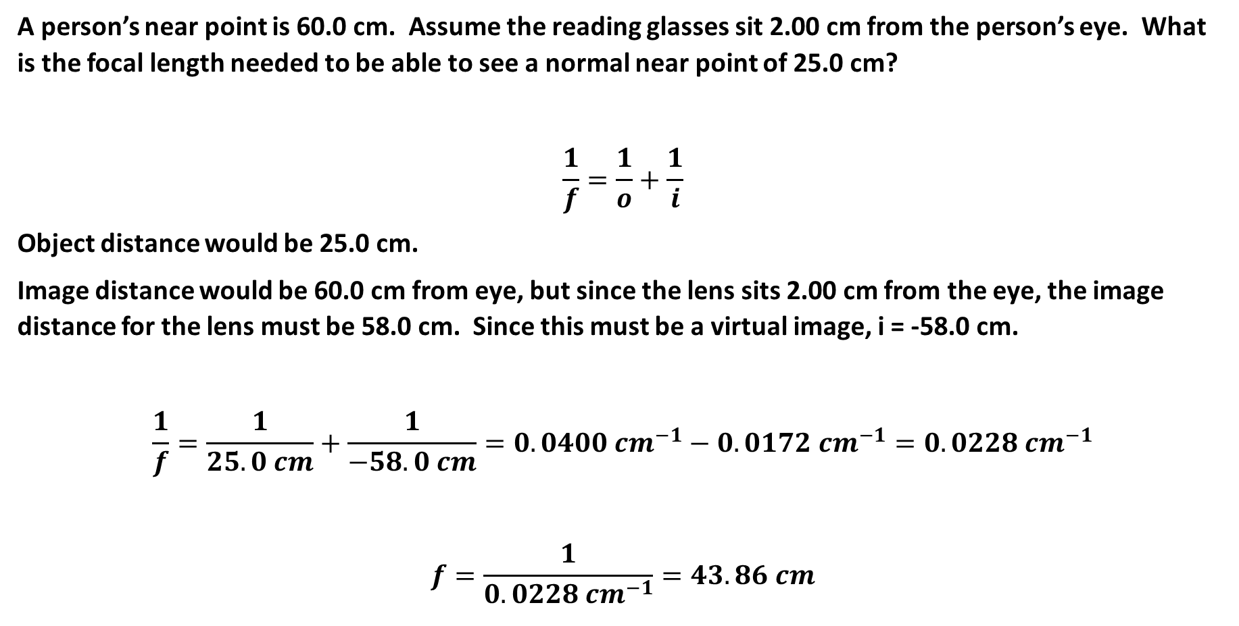
A person’s near point is 60.0 cm. Assume the reading glasses sit 2.00 cm from the person’s eye. What is the focal length needed to be able to see a normal near point of 25.0 cm?
$$\frac{1}{f}=\frac{1}{o}+\frac{1}{i}$$
Object distance would be 25.0 cm.
Image distance would be 60.0 cm from eye, but since the lens sits 2.00 cm from the eye, the image distance for the lens must be 58.0 cm. Since this must be a virtual image, i = -58.0 cm.
$$\frac{1}{f}=\frac{1}{25.0 cm}+\frac{1}{−58.0 cm}=0.0400 {cm}^{−1}−0.0172 {cm}^{−1}=0.0228 {cm}^{−1}$$
$$f=\frac{1}{0.0228 {cm}^{−1}}=43.86 cm$$

Slide 9
26.10 The Human Eye
THE REFRACTIVE POWER OF A LENS – THE DIOPTER
Optometrists who prescribe correctional lenses and the opticians
who make the lenses do not specify the focal length. Instead
they use the concept of refractive power.

Slide 10
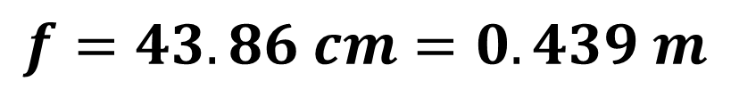
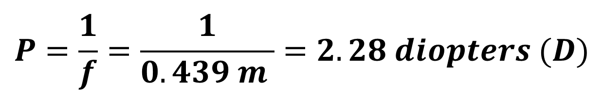
From Previous example
$$f=43.86 cm=0.439 m$$
$$P=\frac{1}{f}=\frac{1}{0.439 m }=2.28 diopters (D)$$

Slide 11
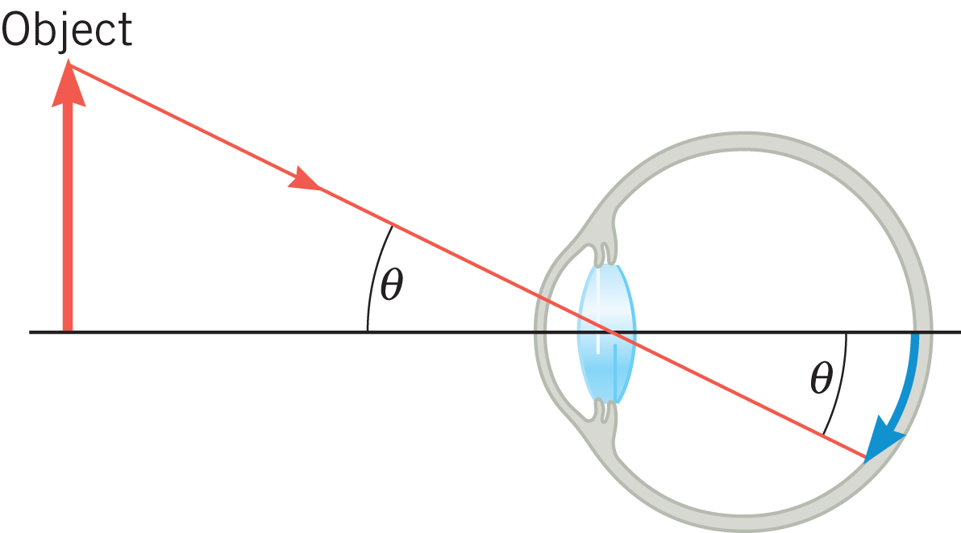
26.11 Angular Magnification and the Magnifying Glass
The size of the image on the retina determines how large
an object appears to be.

Slide 12
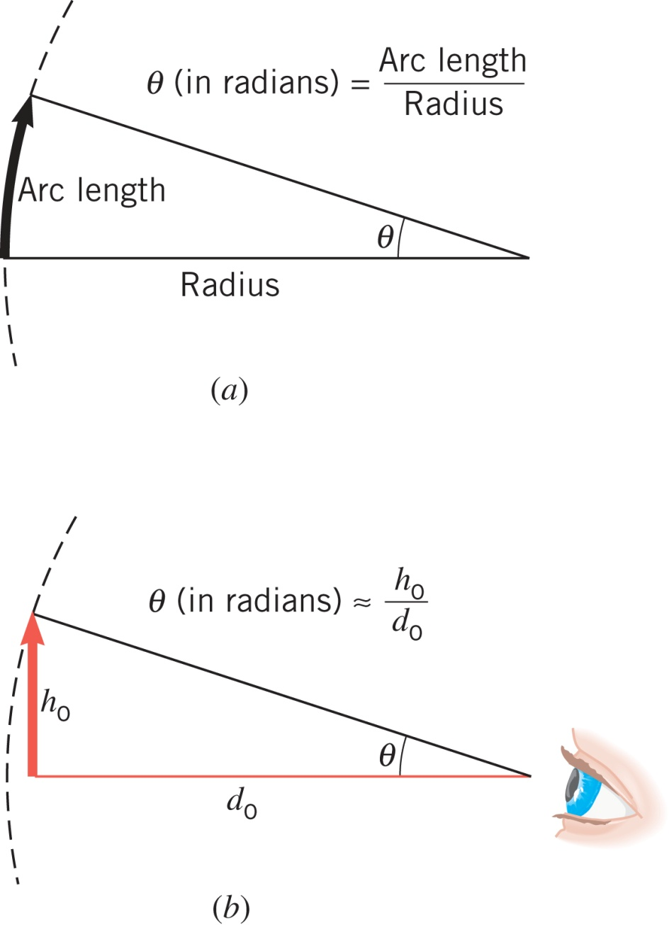
26.11 Angular Magnification and the Magnifying Glass

Slide 13
26.11 Angular Magnification and the Magnifying Glass
Example 14 A Penny and the Moon
Compare the angular size of a penny held at arms length with that of
the moon.
Penny
Moon

Slide 14
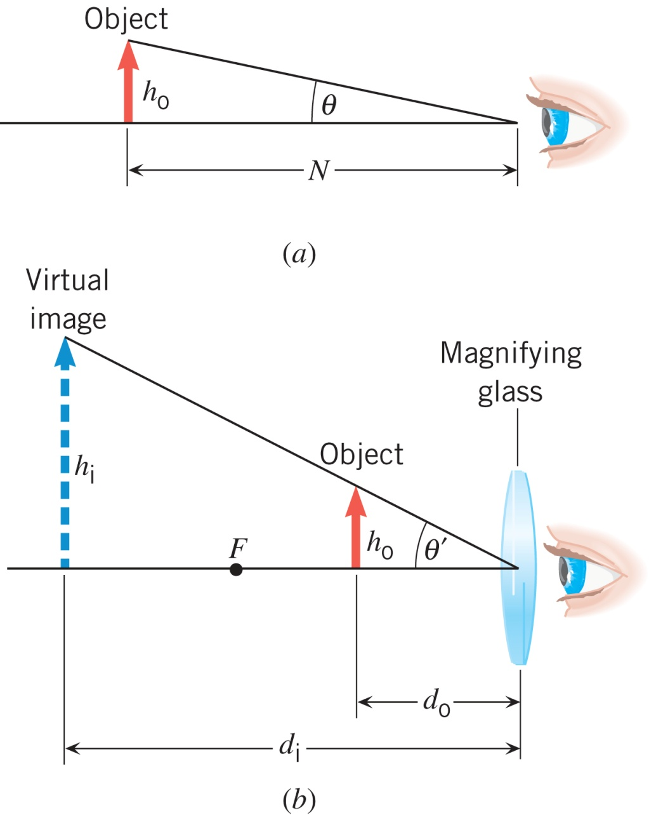
26.11 Angular Magnification and the Magnifying Glass
Angular magnification
Angular magnification
of a magnifying glass

Slide 15
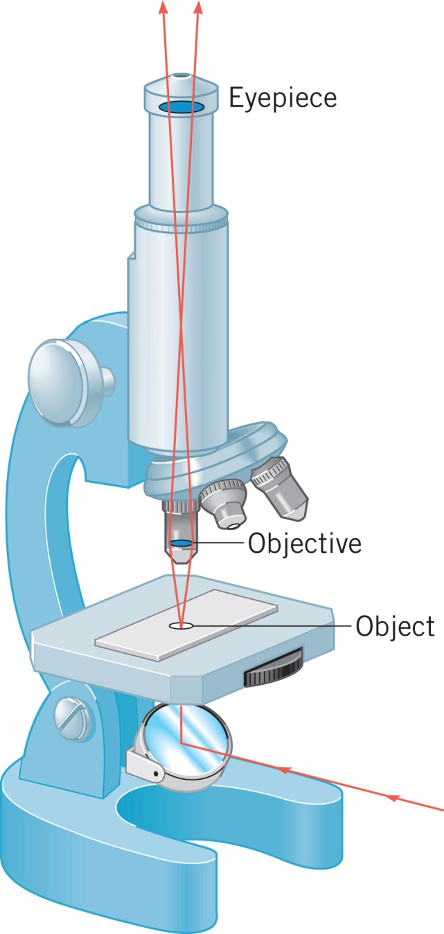
26.12 The Compound Microscope
To increase the angular magnification
beyond that possible with a magnifying
glass, an additional converging lens
can be included to “premagnify” the
object.
Angular magnification of
a compound microscope

Slide 16
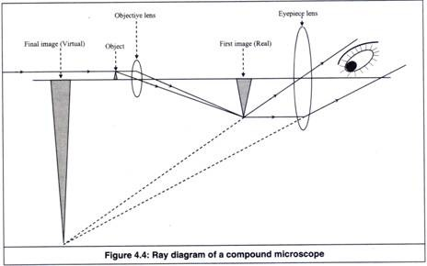
http://resizing.info/iceice.html

Slide 18
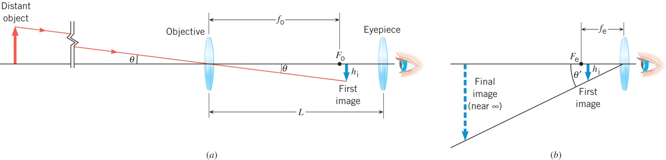
26.13 The Telescope
Angular magnification of
an astronomical telescope

