Slide 1
Light
Light is radiant energy that can travel from one point in space to another without any physical link
c = 2.998 x 10⁸ m/s = 2.998 x 10⁵ km/s in a vacuum (empty space)
v < c in all other media
Early attempts to measure speed of light failed due the great speed, it was believed light traveled instaneously
Galileo

Slide 2
Determining the Speed of Light
Galileo tried unsuccessfully to determine the speed of light using an assistant with a lantern on a distant hilltop

Slide 3
Light travels through empty space at a speed of 300,000 km/s
In 1676, Danish astronomer Olaus Rømer discovered that the exact time of eclipses of Jupiter’s moons depended on the distance of Jupiter to Earth
This happens because it takes varying times for light to travel the varying distance between Earth and Jupiter
Using d=rt with a known distance and a measured time gave the speed (rate) of the light
Notes:
Figure 5-1 Rømer’s Proof That Light Does Not Travel Instantaneously
Thetiming of eclipses of Jupiter’s moons as seen from Earth depends on the
Earth-Jupiter distance. Rømer correctly attributed this effect to variations
in the time required for light to travel from Jupiter to the Earth.

Slide 4
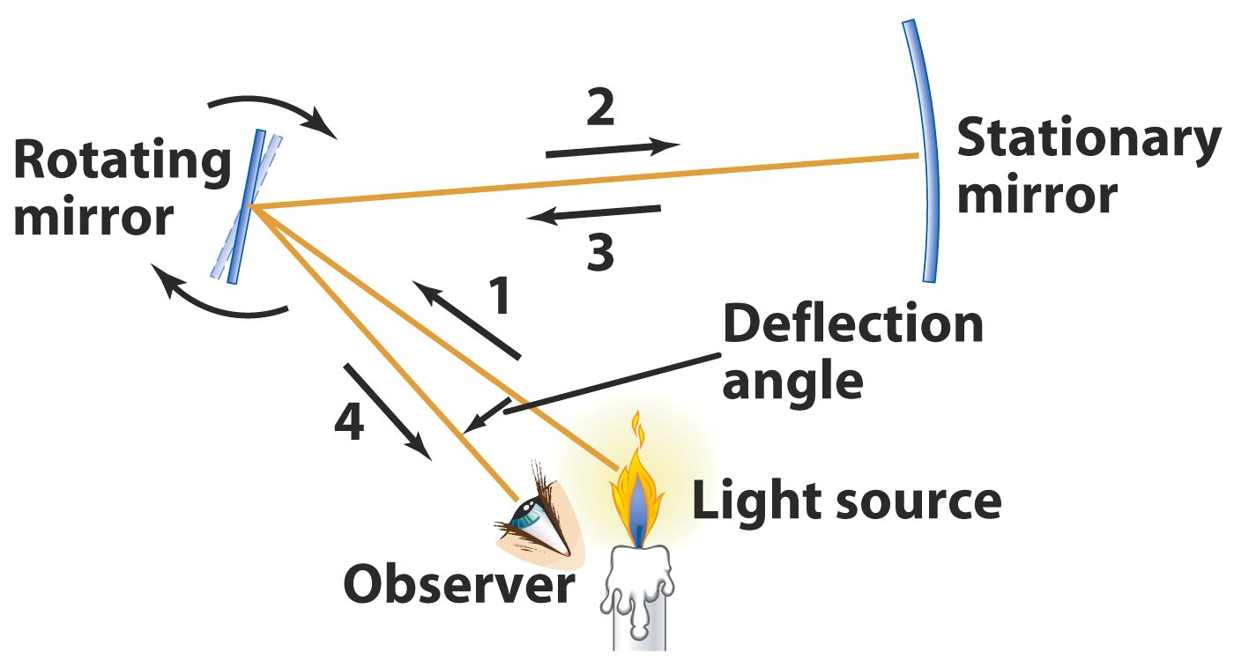
In 1850 Fizeau and Foucalt also experimented with light by bouncing it off a rotating mirror and measuring time
The light returned to its source at a slightly different position because the mirror has moved during the time light was traveling
d=rt again gave c
Notes:
Figure 5-2 The Fizeau-Foucault Method of Measuring the Speed of Light
Light from a light source (1) is reflected off a rotating mirror to a stationary
mirror (2) and from there back to the rotating mirror (3). The ray that
reaches the observer (4) is deflected away from the path of the initial
beam because the rotating mirror has moved slightly while the light was
making the round trip. The speed of light is calculated

Slide 5
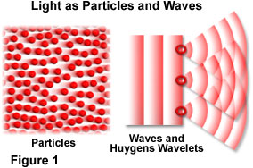
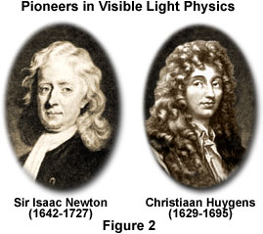
http://www.olympusmicro.com/primer/lightandcolor/particleorwave.html
What is Light???
Newton – Particle
Hyugens – Wave

Slide 6
Why Particle??
Particles can travel through empty space
Particles have well defined positions
Waves require a medium to propagate in
Sound uses air, water, or solids
Water uses water
Light would use???
What is waving in the light wave??

Slide 7
Why Wave??
Changes in frequency or wavelength explain differences in colors
Waves have well defined wavelengths
Waves have well defined energies along a wave front
Waves can interfere and diffract!!

Slide 8
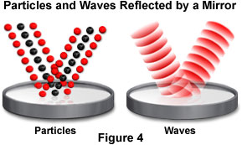
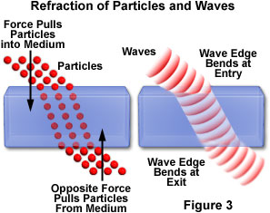
http://www.olympusmicro.com/primer/lightandcolor/particleorwave.html

Slide 9
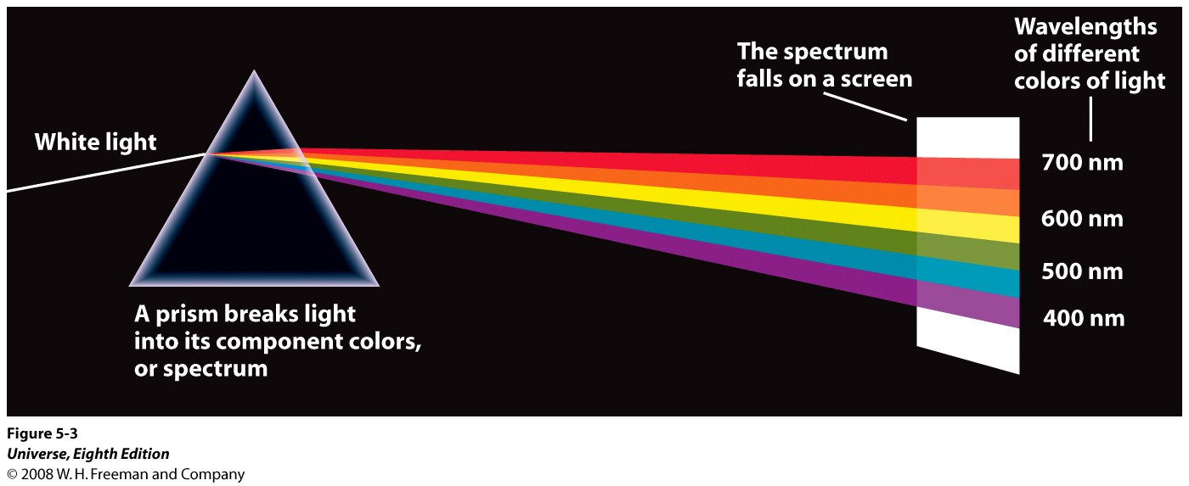
A Prism and a Spectrum
When a beam of sunlight passes through a glass prism, the light is broken into a rainbow-colored band called a spectrum. The wavelengths of different colors of light are shown on the right (1 nm 1 nanometer 10^{–9} m).
Notes:
Figure 5-3 A Prism and a Spectrum
When a beam of sunlight passes through a
glass prism, the light is broken into a rainbow-colored band called a
spectrum. The wavelengths of different colors of light are shown on the
right (1 nm 1 nanometer 10^{–9} m).

Slide 10
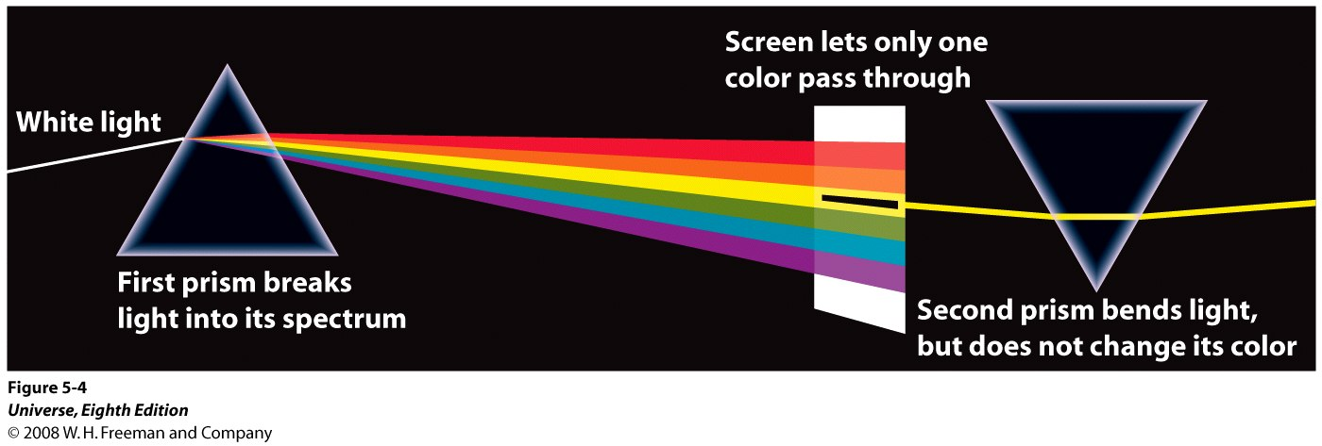
Newton’s Experiment on the Nature of Light
In a crucial experiment, Newton took sunlight that had passed through a prism and sent it through a second prism. Between the two prisms was a screen with a hole in it that allowed only one color of the spectrum to pass through.
This same color emerged from the second prism. Newton’s experiment proved that prisms do not add color to light but merely bend different colors through different angles. It also proved that white light, such as sunlight, is actually a combination of all the colors that appear in its spectrum.
Notes:
Figure 5-4 Newton’s Experiment on the Nature of Light
In a crucial experiment, Newton took sunlight that had passed through a prism and sent it
through a second prism. Between the two prisms was a screen with a
hole in it that allowed only one color of the spectrum to pass through.
This same color emerged from the second prism. Newton’s experiment
proved that prisms do not add color to light but merely bend different
colors through different angles. It also proved that white light, such as
sunlight, is actually a combination of all the colors that appear in its
spectrum.

Slide 11
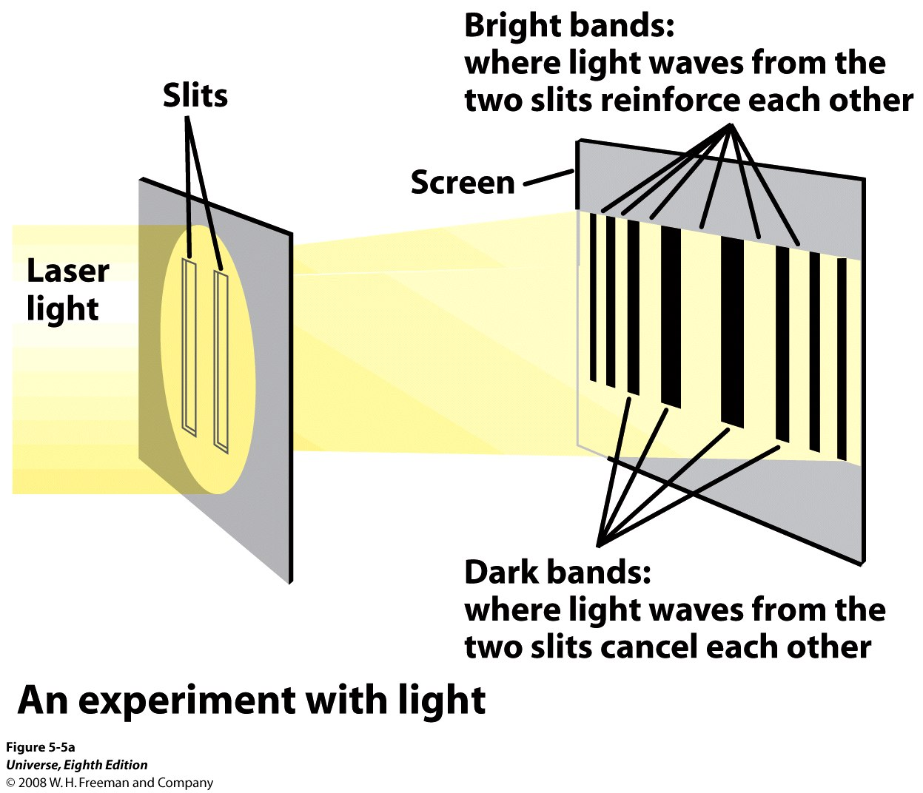
1802 – Thomas Young – Double Slit Experiment
Notes:
Figure 5-5 Young’s Double-Slit Experiment
(a) Thomas Young’s classic double-slit
experiment can easily be repeated in the modern laboratory by shining
light from a laser onto two closely spaced parallel slits. Alternating dark
and bright bands appear on a screen beyond the slits.

Slide 12
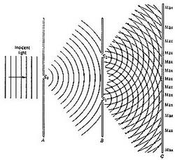
http://7007.homestead.com/files/Eternity_DoubleSlit_Experiment.jpg

Slide 13
Notes:
Figure 5-5 Young’s Double-Slit Experiment
(b) The intensity of light on the screen in (a) is analogous to the height of water waves that
pass through a barrier with two openings. (The photograph shows this
experiment with water waves in a small tank.) In certain locations, wave
crests from both openings reinforce each other to produce extra high
waves. At other locations a crest from one opening meets a trough from
the other. The crest and trough cancel each other, producing still water.
(Eric Schrempp/Photo Researchers)

Slide 14
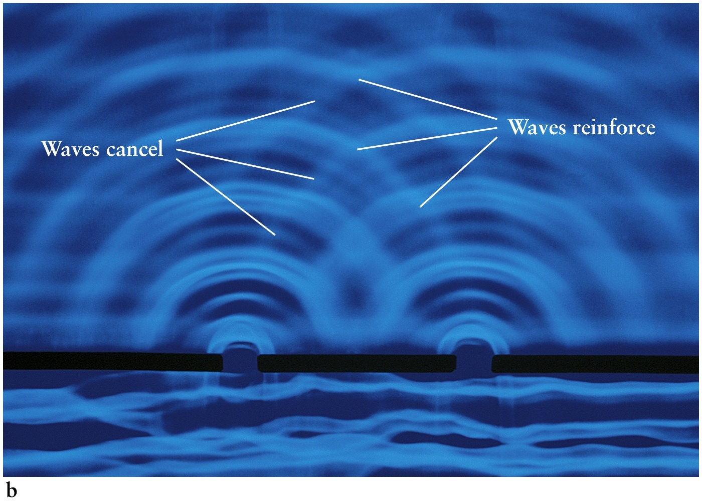

Slide 15
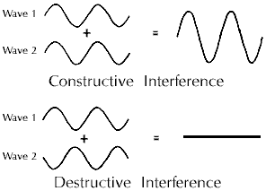
Wave Addition
http://www.space.com/images/if101_1.gif

Slide 16
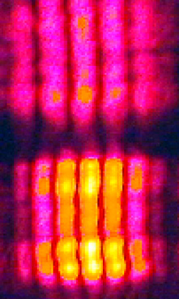
http://www.swgc.mun.ca/physics/images/interference_2slit.jpg
http://faraday.physics.uiowa.edu/images/6d10.12b.jpg

Slide 17
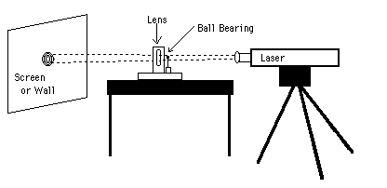
http://hendrix.uoregon.edu/~demo/Demo/Light_and_Optics/Diffraction/Pictures/Poisson_Spot.gif
http://daugerresearch.com/fresnel/blueGrayPoisson.jpg

Slide 18
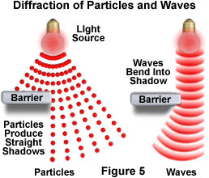
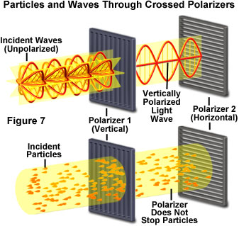
http://www.olympusmicro.com/primer/lightandcolor/particleorwave.html

Slide 19
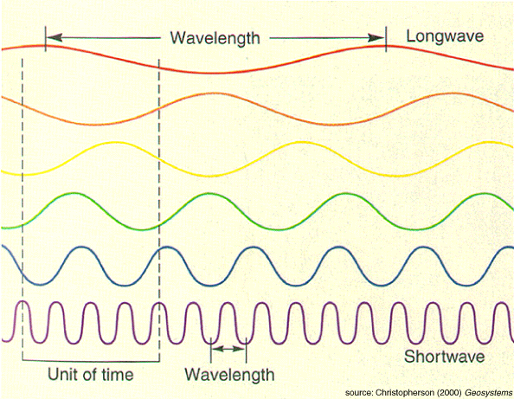
http://geography.uoregon.edu/shinker/geog101/lectures/lec01/lec01_figs/wavelength-and-frequency-fig2-5.gif

Slide 20
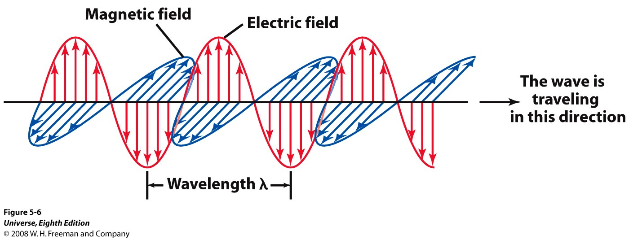
The Nature of Light
In the 1860s, the Scottish mathematician and physicist James Clerk Maxwell succeeded in describing all the basic properties of electricity and magnetism in four equations
This mathematical achievement demonstrated that electric and magnetic forces are really two aspects of the same phenomenon, which we now call electromagnetism
Notes:
Figure 5-6 Electromagnetic Radiation
All forms of light consist of
oscillating electric and magnetic fields that move through
space at a speed of 3.00 105 km/s 3.00 108 m/s. This
figure shows a “snapshot” of these fields at one instant. The
distance between two successive crests, called the
wavelength of the light, is usually designated by the Greek
letter (lambda).

Slide 21
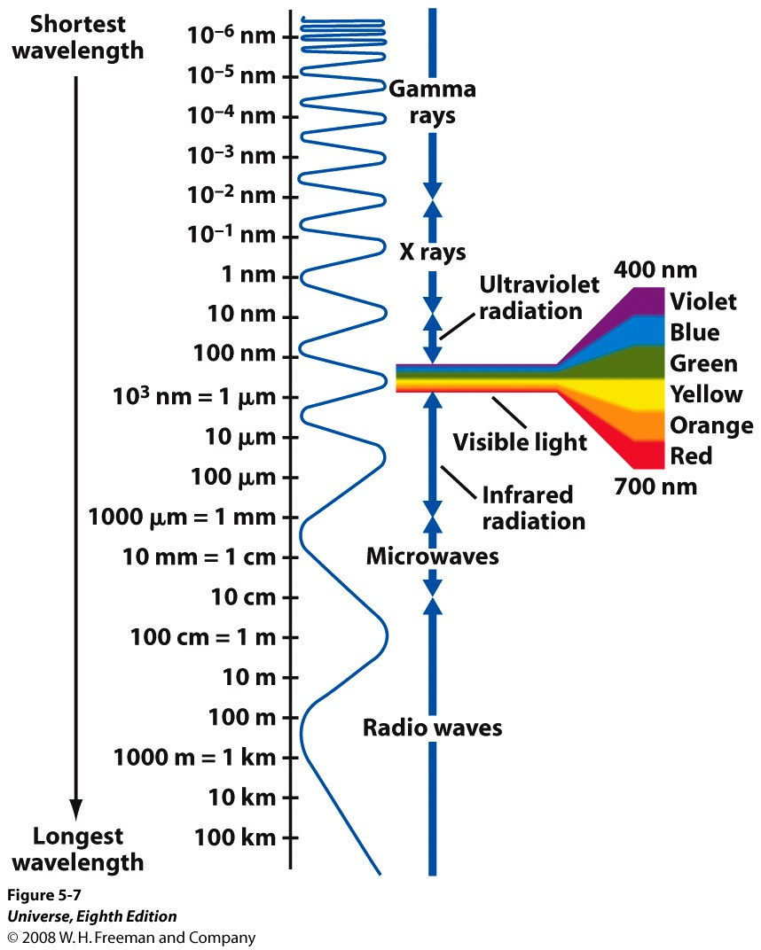
Notes:
Figure 5-7 The Electromagnetic Spectrum
The full array of all types of electromagnetic radiation is called the electromagnetic
spectrum. It extends from the longest-wavelength radio waves to the
shortest-wavelength gamma rays. Visible light occupies only a tiny
portion of the full electromagnetic spectrum.

Slide 22
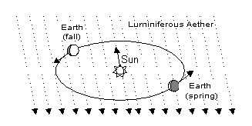
Light is a Wave ??
Aether
http://upload.wikimedia.org/wikipedia/en/thumb/a/a6/327px-AetherWind.png

Slide 23
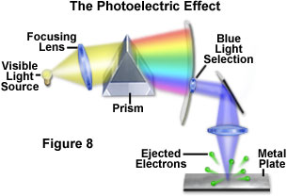
Photo-Electric Effect
http://www.olympusmicro.com/primer/lightandcolor/particleorwave.html

Slide 24
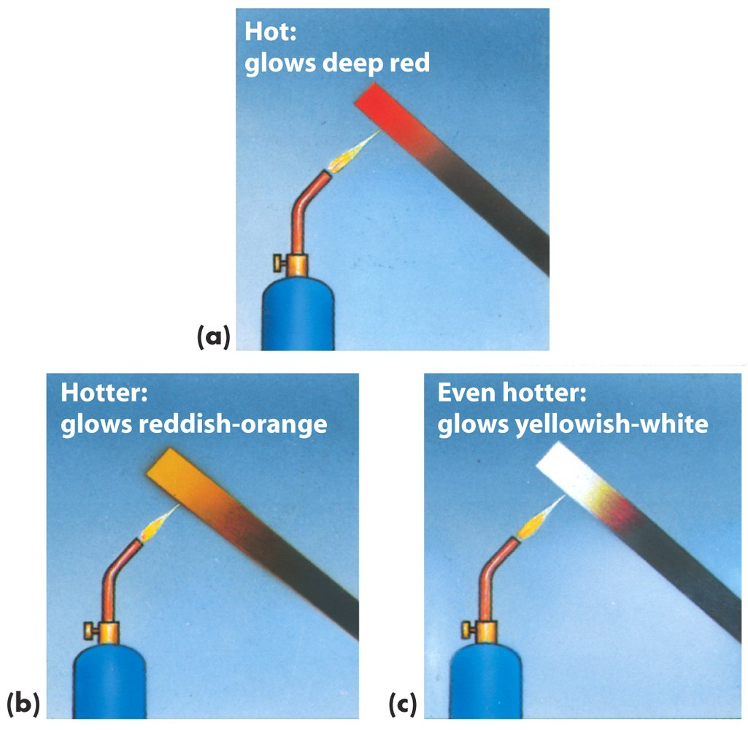
An opaque object emits electromagnetic radiation according to its temperature

Slide 25
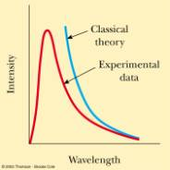
Black Body Radiation – Ultraviolet Catastrophe
http://www.physics.uc.edu/~sitko/CollegePhysicsIII/27-QuantumPhysics/QuantumPhysics_files/image006.jpg

Slide 26
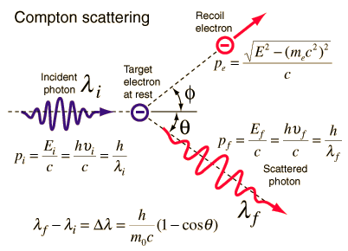
Compton Scattering
http://hyperphysics.phy-astr.gsu.edu/hbase/quantum/imgqua/compton2.gif

Slide 27
Quantum Theory
1900 Planck proposes quantum (“particle”) theory to solve Black-Body problem
1905 Einstein uses quantum theory to explain Photo-electric Effect
Quantum theory also explains Compton Scattering
Light is a particle??
Waves can act like a particle!

Slide 28
Can Particle’s Be Waves??
1917 Louis de Broglie proposes particles have associated wavelengths
1923 Davisson-Germer diffract particles (electrons)
Particles act like waves!!

Slide 29
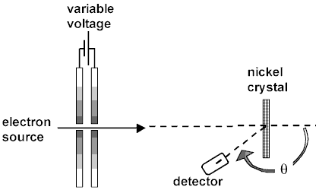
http://online.cctt.org/physicslab/content/PhyAPB/lessonnotes/dualnature/Davisson_Germer.asp

Slide 30
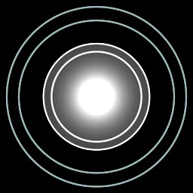
http://online.cctt.org/physicslab/content/PhyAPB/lessonnotes/dualnature/Davisson_Germer.asp
The diffraction patterns simulated above compare the effects of x-rays passing through a thin foil with those of high energy electrons passing through the same medium. Notice how similar the patterns are to each other when the de Broglie wavelength of an electron beam equals the wavelength of the original x-rays. A similar set of images can be viewed at Hackensack High School.

Slide 31
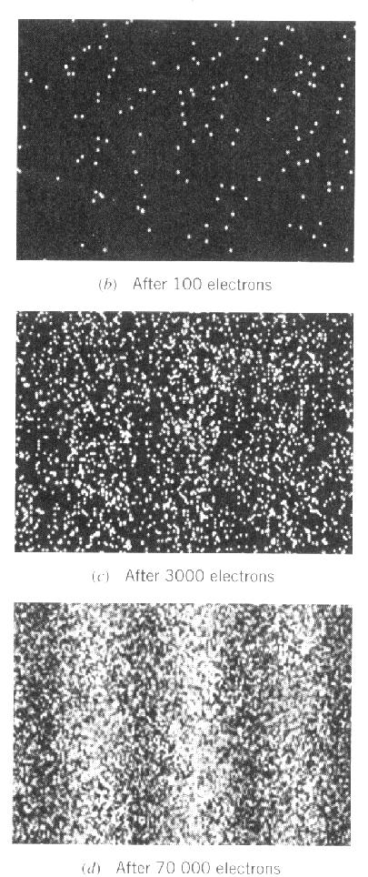
Electron Two Slit Experiments
http://www.physics.brocku.ca/courses/1p92/images/electron_two_slit.jpg

Slide 32
Light has properties of both waves and particles
Newton thought light was in the form of little packets of energy called photons and subsequent experiments with blackbody radiation indicate it has particle-like properties
Young’s Double-Slit Experiment indicated light behaved as a wave
Light has a dual personality; it behaves as a stream of particle like photons, but each photon has wavelike properties

Slide 33
Photons
Planck’s law relates the energy of a photon to its frequency or wavelength
E = energy of a photon
h = Planck’s constant
c = speed of light
= wavelength of light
The value of the constant h in this equation, called Planck’s constant, has been shown in laboratory experiments to be
h = 6.625 x 10^{–34} J s

Slide 34
Wave-Particle Duality
Electromagnetic Radiation is something which under some experimental conditions exhibits wave-like character and other experimental conditions exhibits particle-like character.
E-M Radiation is neither a wave nor a particle directly

Slide 35
Wave Character
λ (Wavelength)
f (Frequency)
Particle Character
E (Energy)
p (Momentum)
Relating Wave Character to Particle Character

