Slide 1
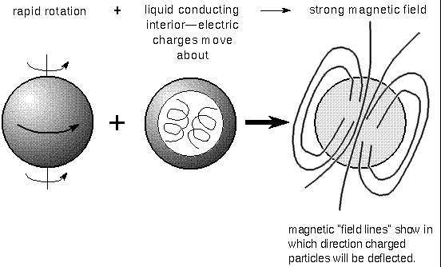
http://www.astronomynotes.com/solarsys/s7.htm

Slide 2
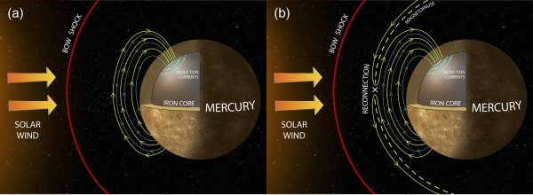
http://lasp.colorado.edu/home/?post_type=science-seminars&p=15037

Slide 3
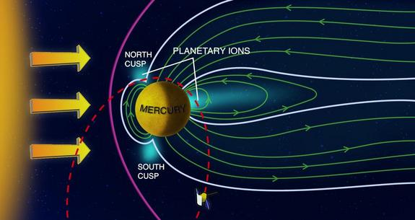
http://www.ascensionearth2012.org/2015/05/mercurys-mysterious-magnetic-past-goes.html

Slide 4
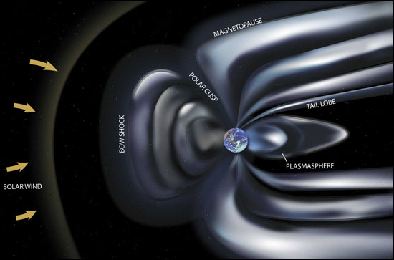
http://www.universetoday.com/27005/earths-magnetic-field/

Slide 5
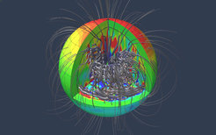
https://www.mpg.de/8373381/two-dynamos_Jupiter

Slide 6
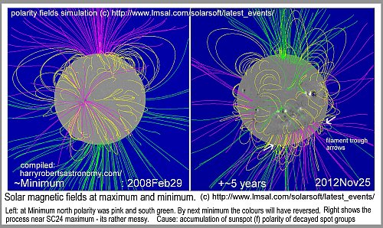
https://maas.museum/observations/2012/12/19/harry-says-that-the-magnetic-fields-on-the-sun-are-reversing-their-polarity/

Slide 7
The Earth’s magnetic field produces a magnetosphere that traps particles from the solar wind
Electric currents in the liquid outer core generate a magnetic field
This magnetic field produces a magnetosphere that surrounds the Earth and blocks the solar wind from hitting the atmosphere
Most of the particles of the solar wind are deflected around the Earth by the magnetosphere.

Slide 8
Magnetic Field Reversals
Earth’s Magnetic Field changes its polarity on an irregular pattern that varies from 10’s of thousands of years to 100’s of thousands of years
Sun’s Magnetic Field reverses Polarity every 11 years!

Slide 9
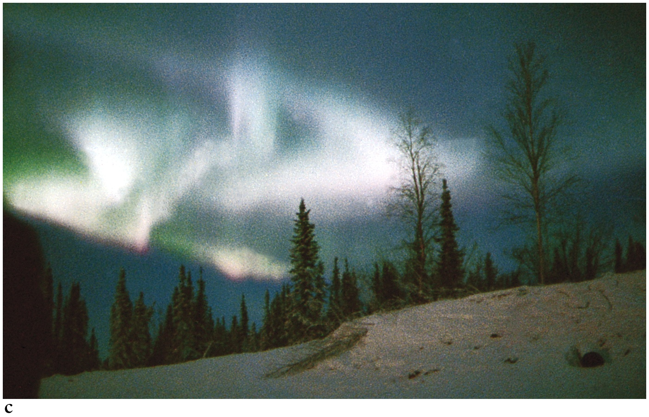

Slide 10
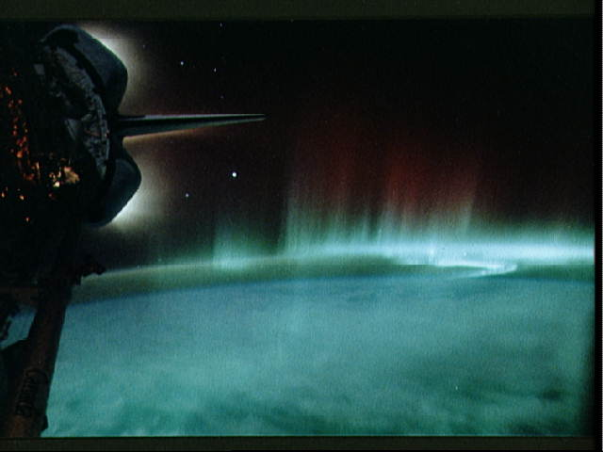

Slide 11
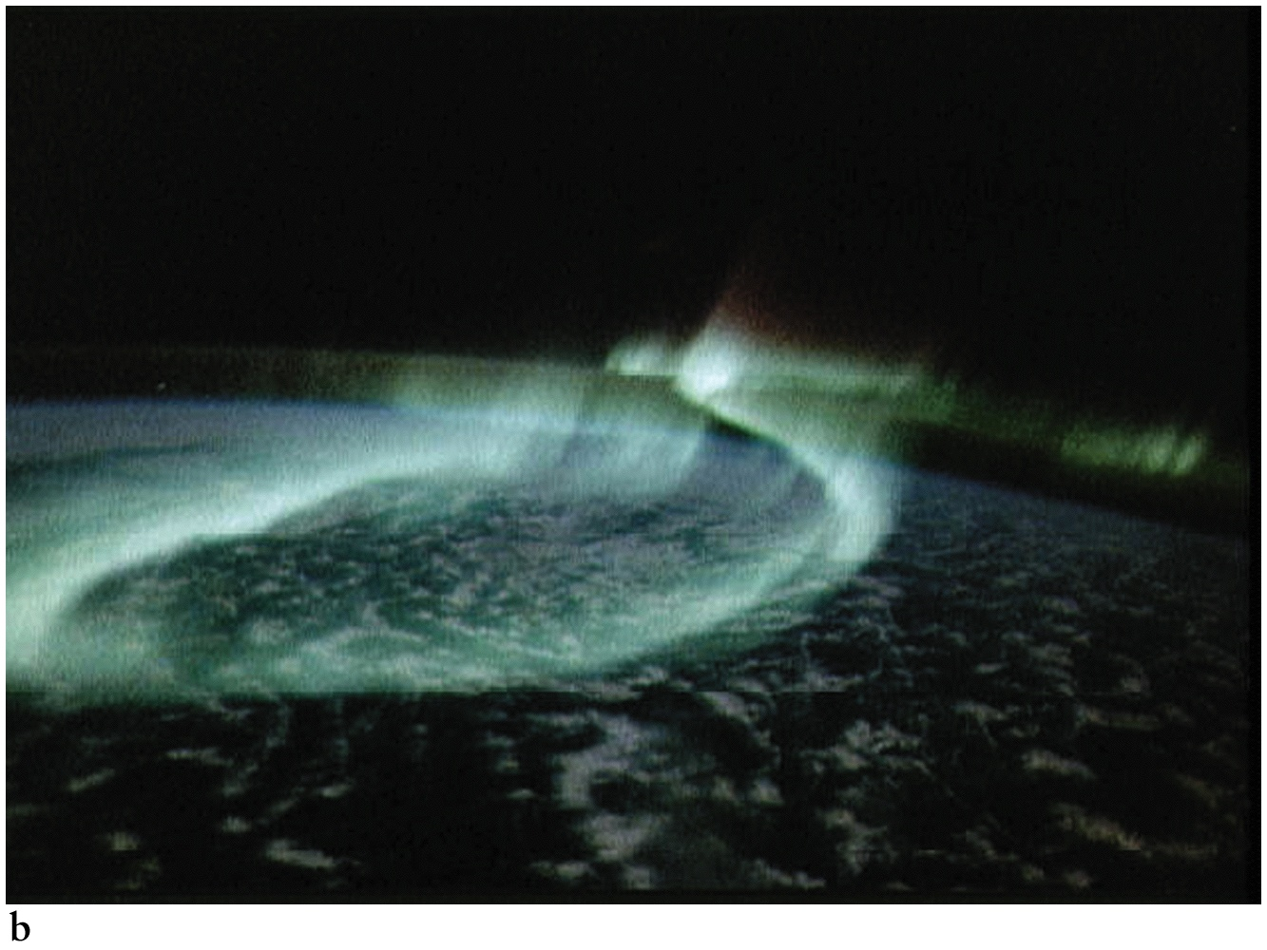

Slide 12
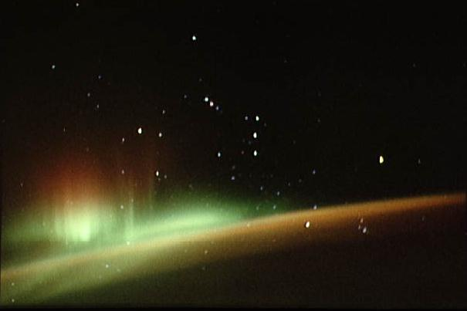

Slide 13
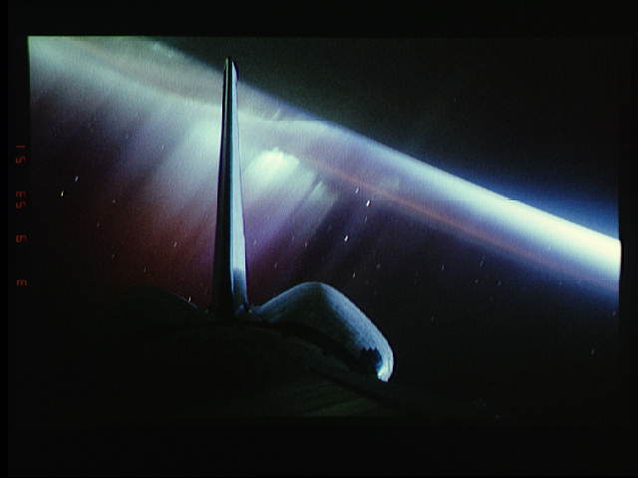

Slide 14
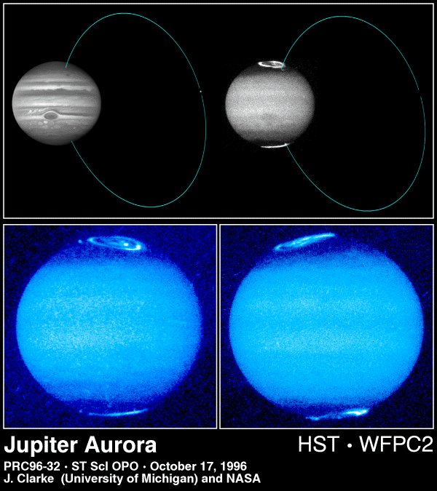

Slide 15
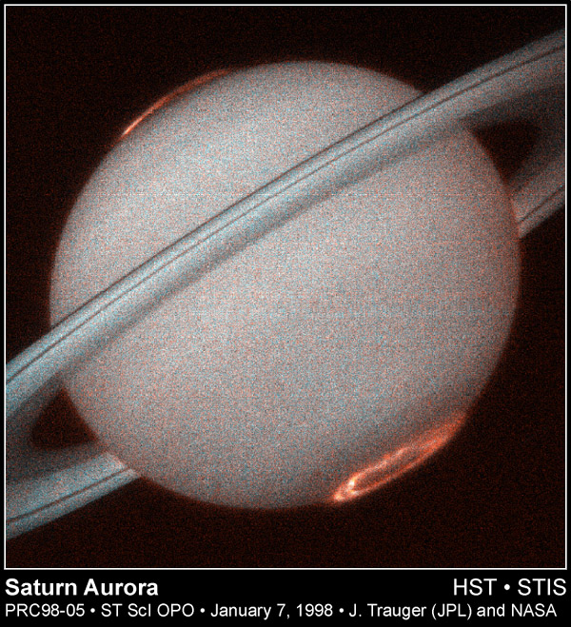

Slide 16
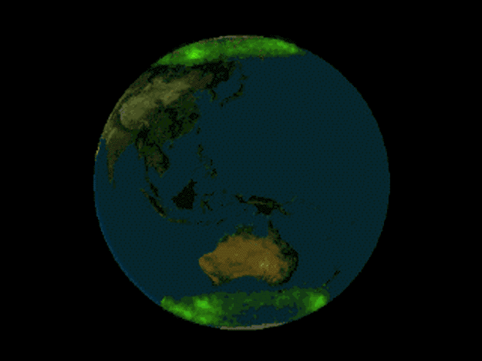

Slide 17
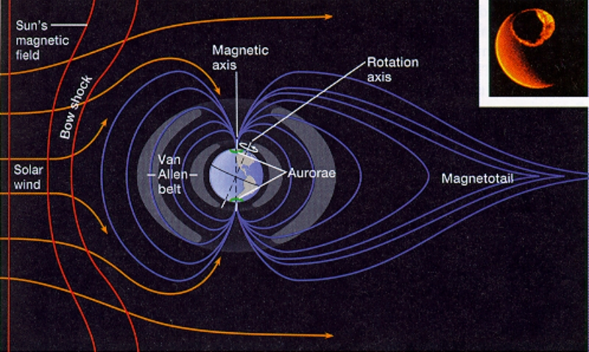

Slide 18
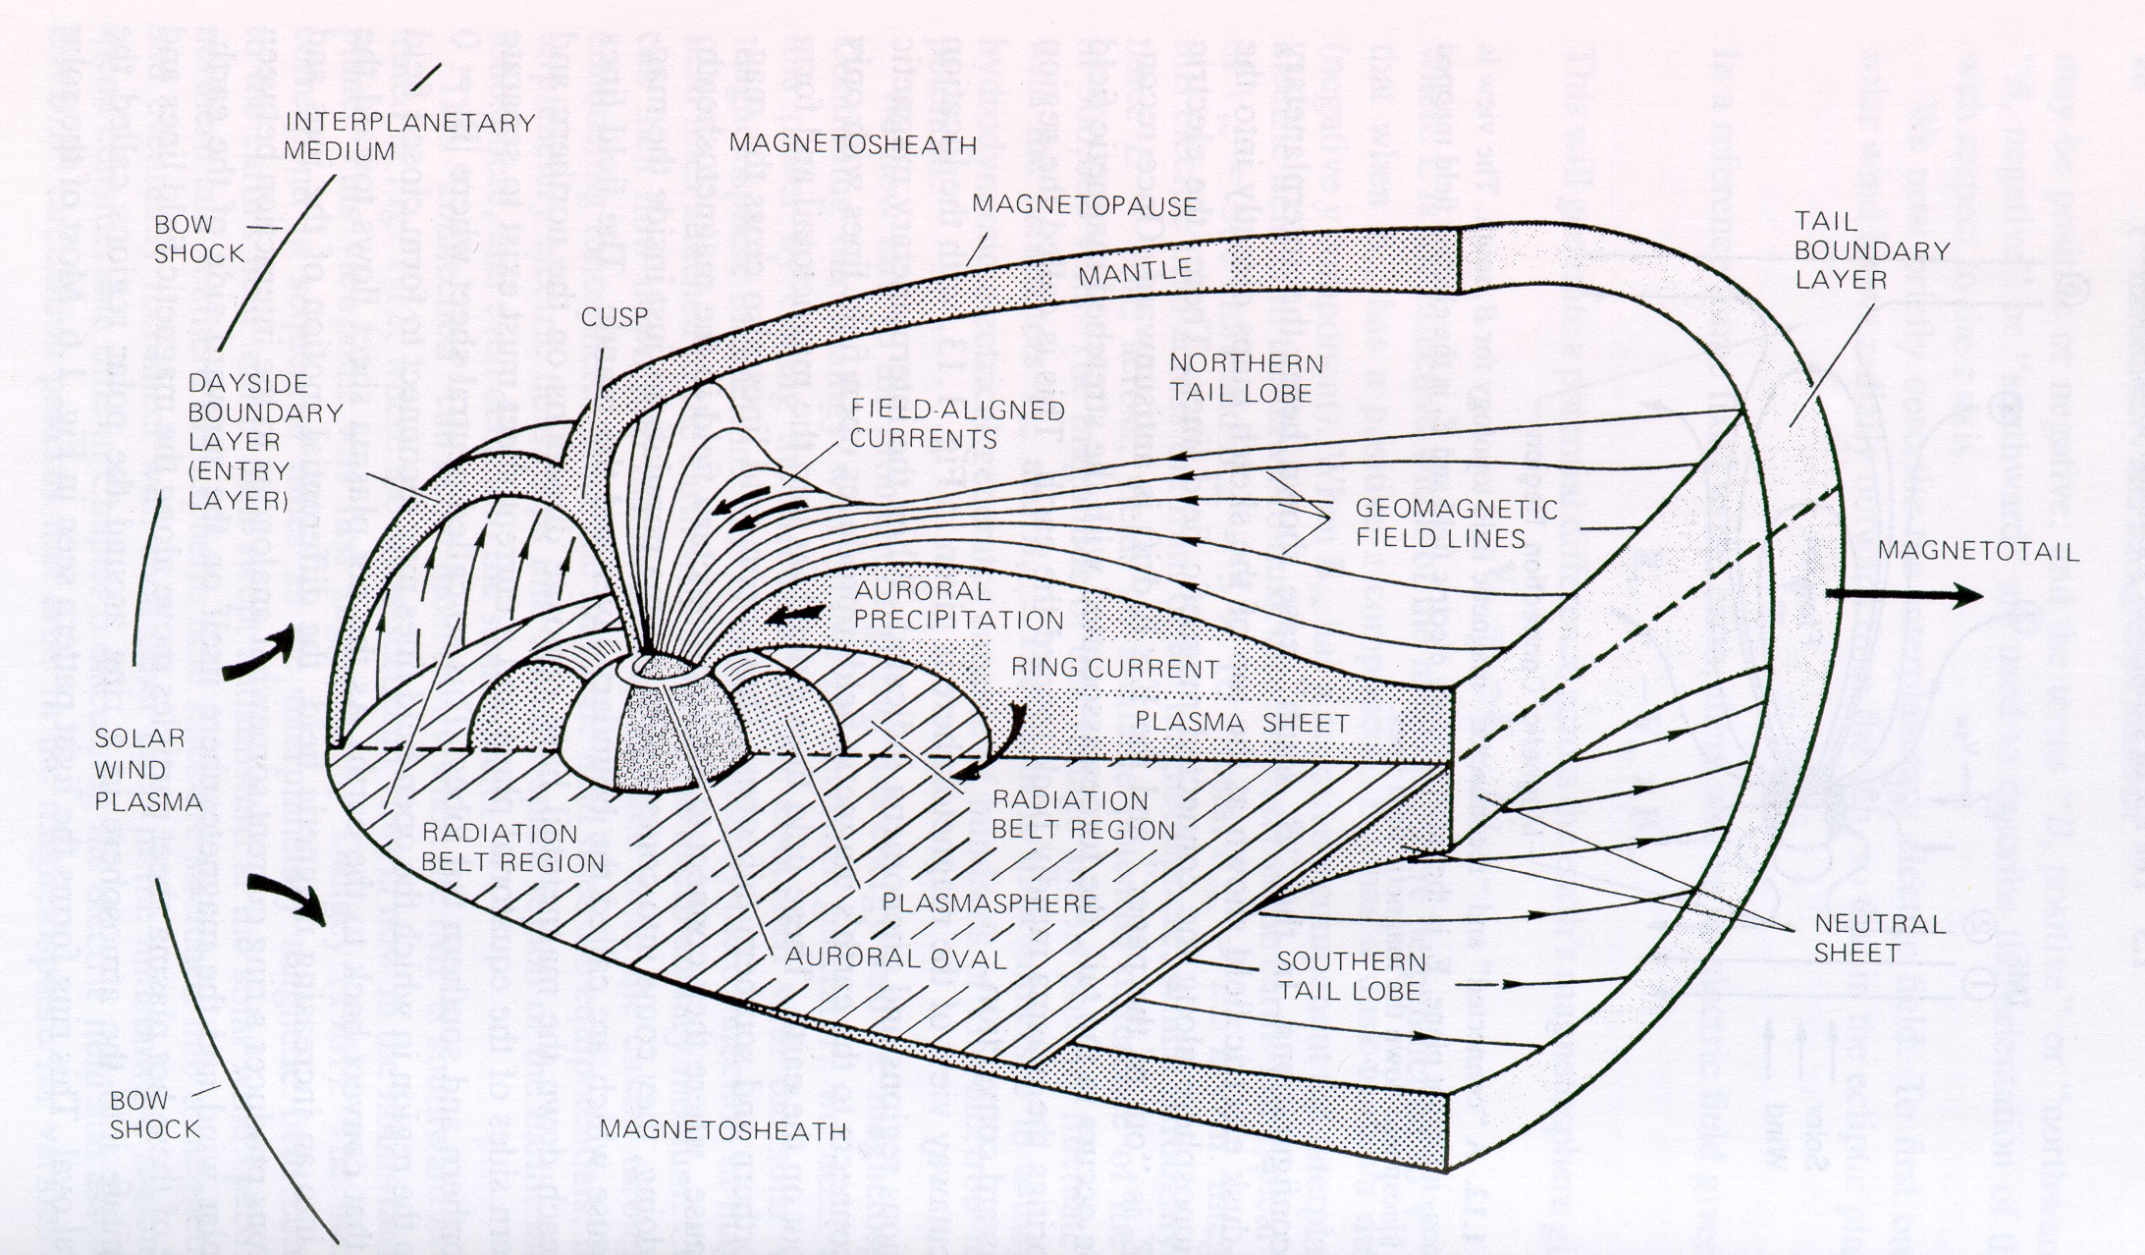

Slide 19
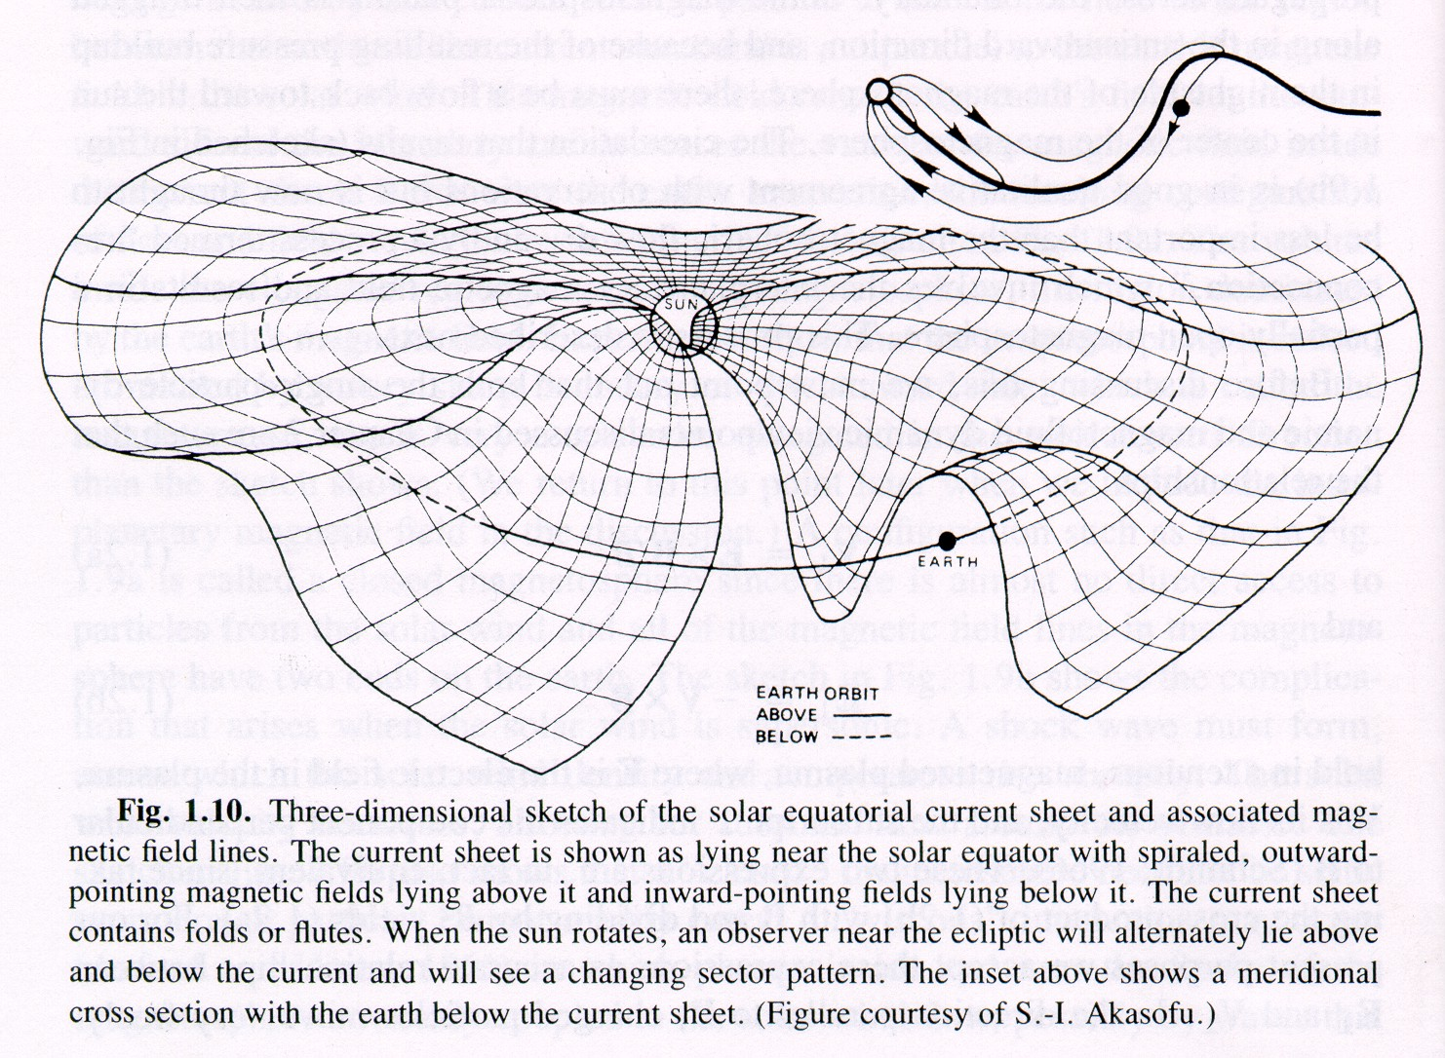

Slide 20
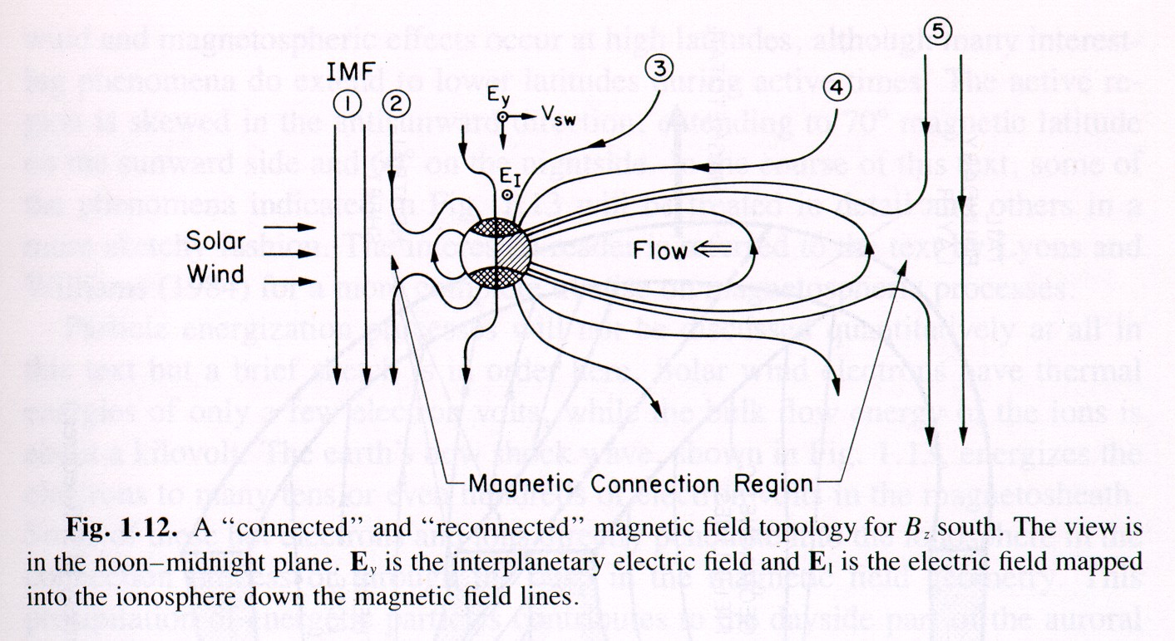

Slide 21
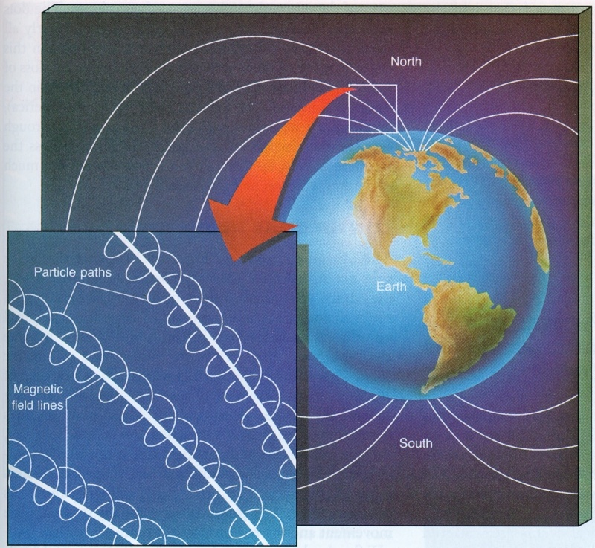

Slide 22
http://sohowww.nascom.nasa.gov/spaceweather/
What is space weather ?
"conditions on the Sun and in the solar wind, magnetosphere, ionosphere and thermosphere that can influence the performance and reliability of space-borne and ground-based technological systems and can endanger human life or health."

Slide 23
Why Care about Space Weather?
Earth-Space Activities ... disrupted by solar and geomagnetic events
Satellite operations
Navigation
Space Shuttle and Space Station activities
High-altitude polar flights
Electric power distribution
Long-line telephone communication
HF radio communication
Pipeline operations
Geophysical exploration
http://www.sec.noaa.gov/info/SolarEffects.html

Slide 24
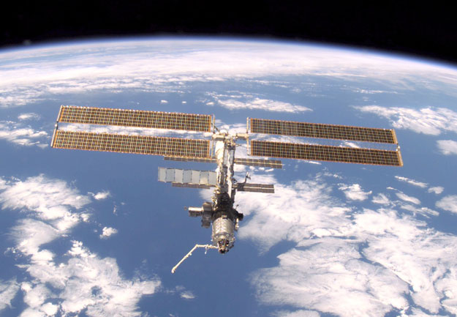

Slide 25
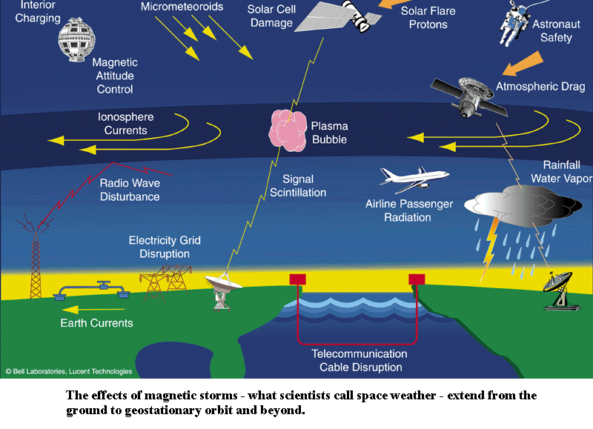
http://www-istp.gsfc.nasa.gov/istp/outreach/cmeposter/images/blackout1big.gif

Slide 26
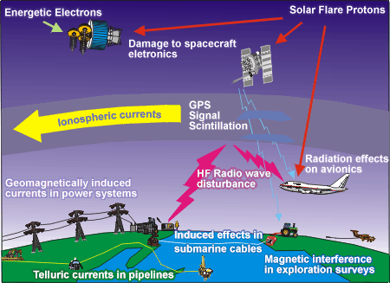
http://www.spaceweather.gc.ca/effects_e.shtml

Slide 27
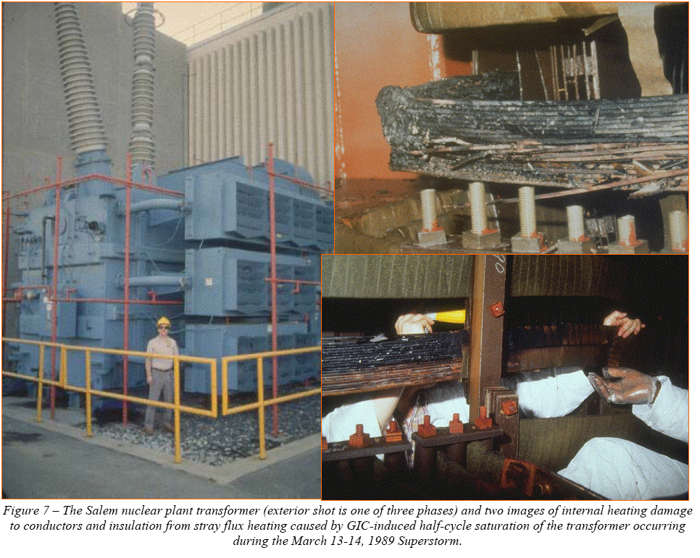

Slide 28
Halloween 2003 (Oct-Nov)
The largest X-ray solar flare ever recorded
The fastest-moving solar storm ever. It splashed over us at nearly 6 million mph.
The hottest storm ever. It was tens of millions of degrees as it doused Earth.
power outages in Sweden
disturbed airplane routes around the world, and
damaged 28 satellites, ending the service life of two.
http://www.spacetoday.org/SolSys/Sun/SunStormsRecordYr.html

Slide 29
Halloween 2003 (Oct-Nov)
Burned out the radiation monitor aboard the Global Surveyor spacecraft orbiting Mars. That instrument had been tracking the radiation future explorers might encounter on trips to the Red Planet.
And beyond Mars near the planet Saturn, the Cassini spacecraft measured the intense energy from the Sun.
Months later, the energy from the storm reached beyond Pluto's orbit to the edge of the Solar System, washing over the Voyager spacecraft
http://www.spacetoday.org/SolSys/Sun/SunStormsRecordYr.html

Slide 30
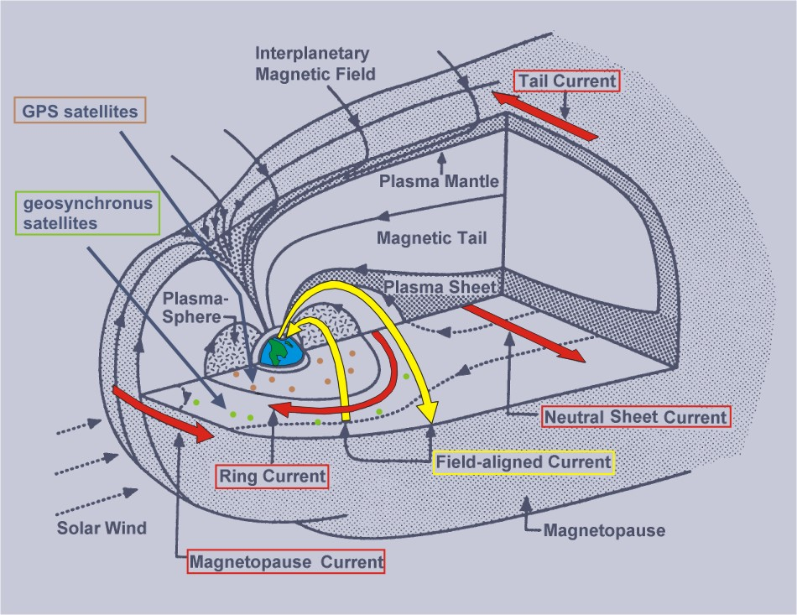
http://www.ngdc.noaa.gov/seg/geomag/icons/ringcurrent.jpg

