Slide 3
Einstein’s Achievements
Relativity
  Explains precession of Mercury’s orbit
  Gravitational bending of light
    Proven by Eclipse photos in 1920’s
    Explains gravitational lensing effects observed
Cosmological Constant??
  Expansion of Universe

Slide 4
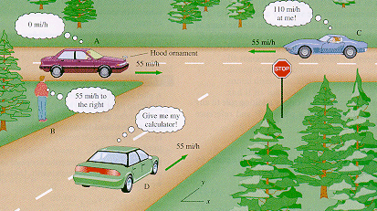
http://www.lebanon.k12.mo.us/lhs/faculty/mwhitacre/newton.html

Slide 5
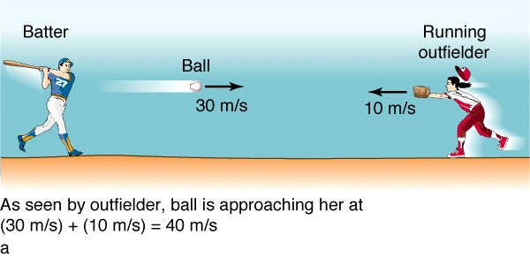
http://frigg.physastro.mnsu.edu/~eskridge/astr101/kauf24_1a.JPG

Slide 6
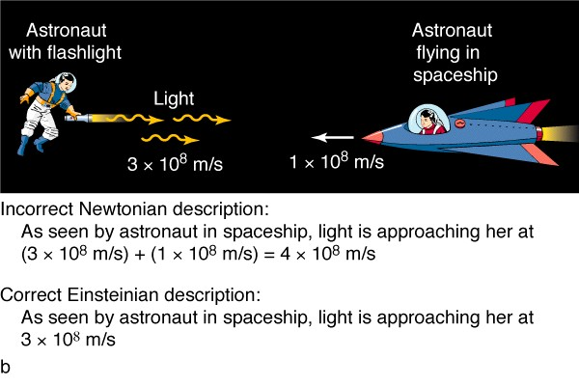
http://frigg.physastro.mnsu.edu/~eskridge/astr101/kauf24_1b.JPG

Slide 7
Einstein’s Postulates
Theory of Relativity – The laws of Physics must have the same form in all inertial reference frames
Theory of Constancy for the Speed of Light – All Observers measure the same speed of light
Another way is c < or = to 2.998 x 10⁸ m/s in a vacuum.

Slide 8
Special vs General Relativity
1905
Two frames of reference differ by constant v
Train Paradox

Slide 9
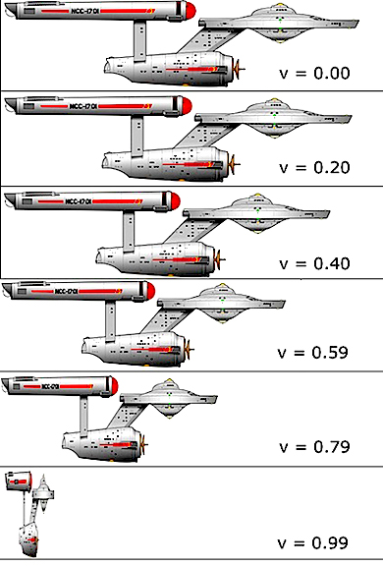
http://cosmology.com/TimeTravel1.html

Slide 10
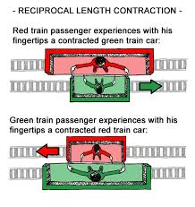
http://www.herongyang.com/Physics/Length-Contraction-Reciprocity.html

Slide 11
Special vs General Relativity
1905
Two frames of reference differ by constant v
Train Paradox
Twin Paradox

Slide 12
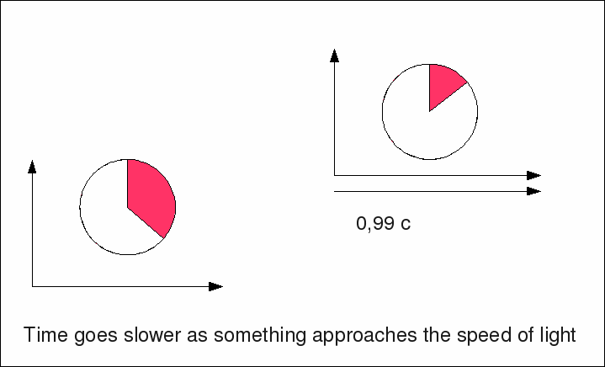
https://www-zeuthen.desy.de/exps/physik_begreifen/orlando/time_dilation.html

Slide 13
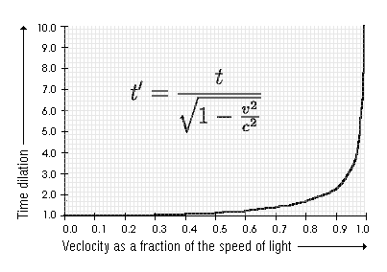
http://www.drummerworld.com/forums/showthread.php?t=112794

Slide 14
Special vs General Relativity
1905
Two frames of reference differ by constant v
Train Paradox
Twin Paradox
1915
Two frames of reference differ by constant a

Slide 15
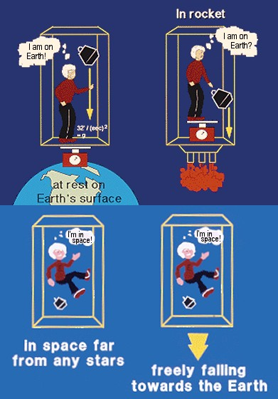
http://www.physicsoftheuniverse.com/topics_relativity_gravity.html

Slide 16
Special vs General Relativity
1905
Two frames of reference differ by constant v
Train Paradox
Twin Paradox
1915
Two frames of reference differ by constant a
Tidal Forces
Theory of Gravity

Slide 17
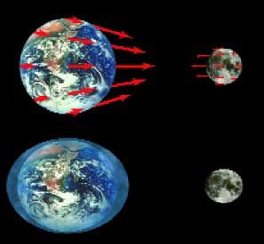
http://www.nap.edu/html/oneuniverse/images/motion_47.jpg

Slide 18
http://physicalworld.org/restless_universe/html/ru_4_24.html
The central ideas of general relativity have been neatly summarized by the American physicist John Archibald Wheeler. In a now famous phrase Wheeler said:
'Matter tells space how to curve.
Space tells matter how to move.'

Slide 19
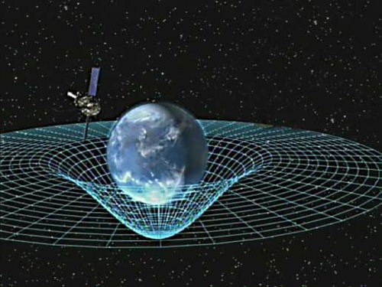
http://thequantumlife.tumblr.com/post/16160919791/gravity-bends-more-than-just-space-it-bends

Slide 20
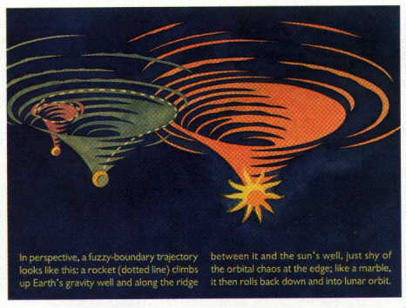
http://users.rcn.com/zap.dnai/astronomy/gravity.htm

Slide 21
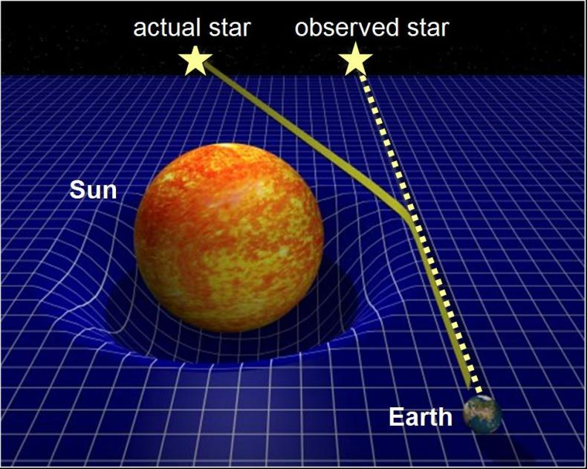
Test #1 Light bending
http://faculty-staff.ou.edu/B/Peter.Barker-1/3023/boardwork3-1.html

Slide 22
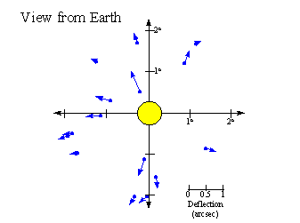
http://www-astronomy.mps.ohio-state.edu/~pogge/Ast162/Unit5/bend2.gif

Slide 23
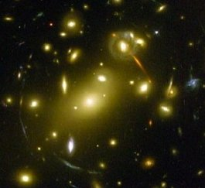
http://science.nasa.gov/headlines/y2004/images/einstein/lensing_med.jpg

Slide 24
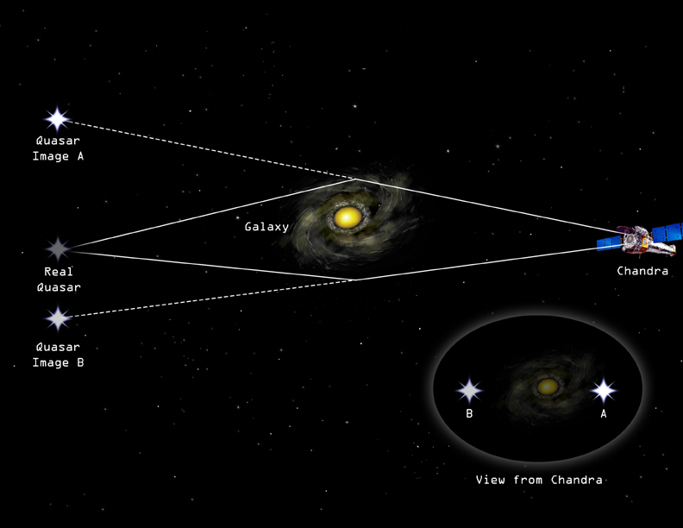
http://chandra.harvard.edu/photo/2003/apm08279/apm08279_grav_lens.jpg

Slide 25
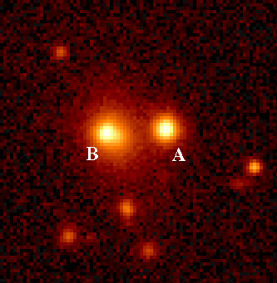
http://www.upscale.utoronto.ca/GeneralInterest/Key/relgen.htm
This is one of the first multiply-imaged sources discovered in 1979 (by Walsh, Carswell and Weymann). Points A and B are images of the same distant source (quasar 0957+561), produced by light bending round a closer massive object that produces no image on this photograph.

Slide 26
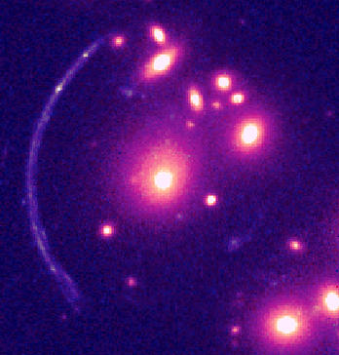
http://www.upscale.utoronto.ca/GeneralInterest/Key/relgen.htm
This is one of the first so-called 'giant arcs', C12244-02, viewed by the Hubble Space Telescope.

Slide 27
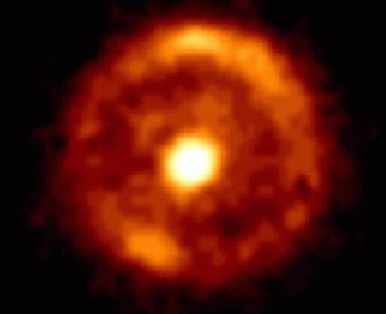
http://www.upscale.utoronto.ca/GeneralInterest/Key/relgen.htm
In this case the foreground galaxy, shown by the bright spot at the centre of the picture is so perfectly aligned with the distant galaxy that the image of the latter becomes an almost perfect Einstein Ring. This picture was taken using the Hubble Space Telescope, by J.L. King, University of Manchester.

Slide 28
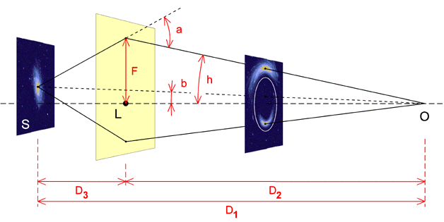
http://leo.astronomy.cz/grlens/fig1.gif

Slide 29
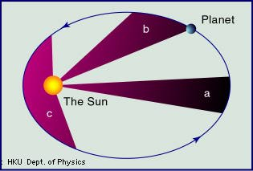
http://www.hyperhistory.com/online_n2/people_n2/science_n2/images/keplerlaw.jpg

Slide 30
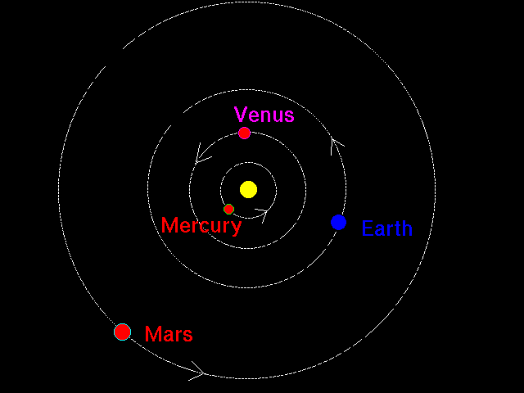
http://zebu.uoregon.edu/~soper/Orbits/planetorbits.gif

Slide 31
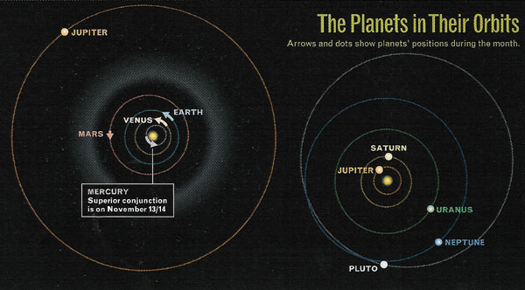
http://www.starryland.com/mailzine/image/071/planet_orbits.jpg

Slide 32
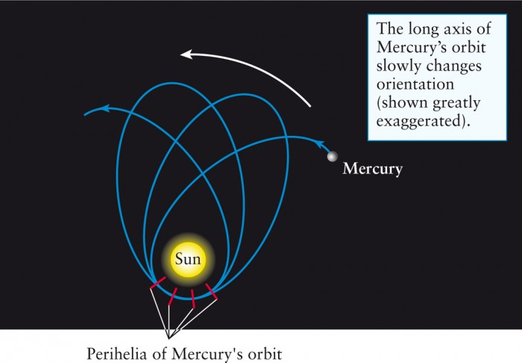
Test #2 Mercury’s orbit
http://biology-forums.com/index.php?action=gallery;sa=view;id=18683

Slide 33
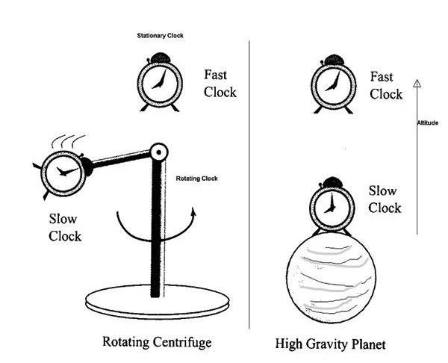
Test #3 Gravitational Red-Shifts or Gravitational Slowing of time
http://scienceblogs.com/startswithabang/2013/01/09/a-though-experiment-for-the-relativity-skeptics/

Slide 34
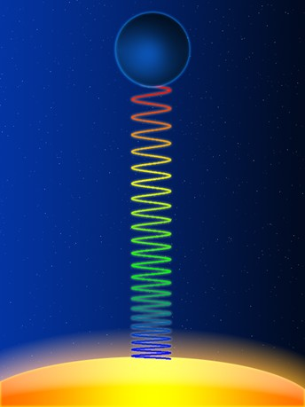
Test #3 Gravitational Red-Shifts or Gravitational Slowing of time
http://slideplayer.com/slide/5682491/

Slide 35
Doppler Red-Shift – the radiation is changed (longer wavelength) because of relative motion between the source and the observer.
Gravitational Red-Shift – the radiation is changed (longer wavelength) because either time or space changes.
Doppler Red-Shifts can never indicate motion greater than c
Gravitational Red-Shifts can imply motion greater than c but it is because the space or time was changed, not local faster than c travel!!

Slide 36
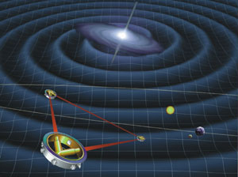
Test #4 Gravity Waves http://spaceplace.nasa.gov/en/kids/lisa_fact2.shtml
The Laser Interferometer (in-ter-fear-AH-
muh-ter) Space Antenna (LISA) is a space mission that will be able to detect some of these gravitational waves, like a huge astronomical microphone. If NASA decides to pay for this mission, it will be launched around 2020.

Slide 37
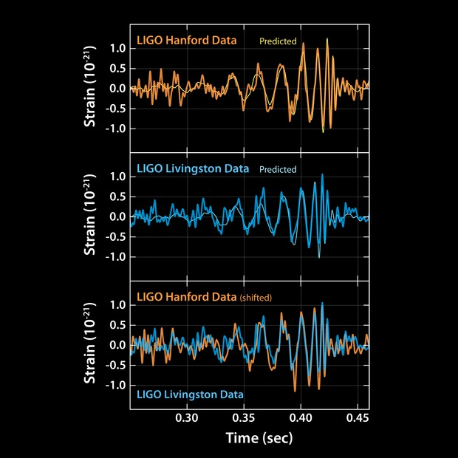
https://www.ligo.caltech.edu/image/ligo20160211a

Slide 38
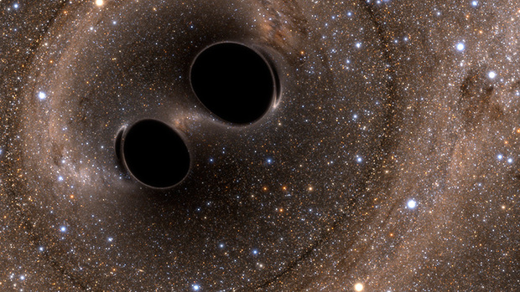
https://www.ligo.caltech.edu/news/ligo20160211

